Slide 1


Land Resource Inventory of Balepalli Micro-watershed
Doddaballapura Taluk, Bangalore Rural District, Karnataka
Watershed Development to Prevent Drought
funded by Watershed Development Department, Govt. of Karnataka, Bangalore
University of Agricultural Sciences, Bangalore
Watershed Development Department, Govt. of Karnataka, Bangalore

Slide 2
Contents
Chapter | Page | Chapter | Page
Contributors | i | 5.12. Available Manganese | 20
How to read and use the atlas | ii | 5.13. Available Zinc | 20
Physical, Cultural and Scientific symbols used | iii | 5.14. Available Boron | 21
1.Introduction | 1-2 | 6. Land Capability Classification | 22
2.General Description of the Micro-watershed | 3-8 | 7. Land Suitability for Major Crops | 23-27
2.1.Location and Extent | 3 | 7.1 Cereals | 23-24
2.2.Geology | 4 | 7.1.1 Land Suitability for Maize | 23
2.3.Satellite Image | 5 | 7.1.2 Land Suitability for Ragi and Minor millets | 24
2.4.Grids overlaid on cadastral map | 6 | 7.2 Pulses | 24
2.5.Current Land use | 7 | 7.2.1 Land Suitability for Redgram | 24
3.Survey Methodology | 8 | 7.2.2 Land Suitability for Field bean | 24
4.Soil Survey Interpretations | 9-16 | 7.3 Oilseeds | 24
4.1.Surface Soil Texture | 9 | 7.3.1 Land Suitability for Groundnut | 24
4.2.Slope | 10 | 7.4 Vegetable/ Fruit crops | 25-26
4.3.Soil Erosion | 11 | 7.4.1 Land Suitability for Tomato | 25
4.4. Soil Gravelliness | 12 | 7.4.2 Land Suitability for Chilli | 25
4.5.Soil Depth | 13 | 7.4.3 Land Suitability for Amla | 25
4.6.Soils | 14 | 7.4.4 Land Suitability for Guava | 25
4.7.Soil Map Unit Description | 15-16 | 7.4.6 Land Suitability for Jackfruit | 26
5.Soil Fertility Status | 17-21 | 7.4.6 Land Suitability for Lime | 26
5.1. Soil Reaction (pH) | 17 | 7.4.7 Land Suitability for Mango | 26
5.2. Electrical Conductivity | 18 | 7.4.8 Land Suitability for Sapota | 26
5.3. Organic Carbon | 18 | 7.5 Plantation Crops | 27
5.4. Available Nitrogen | 18 | 7.5.1 Land Suitability for Coconut | 27
5.5. Available Phosphorus | 18 | 7.5.2 Land Suitability for Cashew | 27
5.6. Available Potassium | 19 | 8. Land Management Unit | 28
5.7. Exchangeable Calcium | 19 | 9. Proposed Crop Plan | 29-30
5.8. Exchangeable Magnesium | 19 | 10. Location of Borewells and Farmpond | 31
5.9. Available Sulphur | 19 | 11. Status of Bunding | 32
5.10. Available Copper | 20 | 12. Conservation measures | 33
5.11. Available Iron | 20 | 13. Conclusion | 34

Slide 3
WDPD Project Department of Soil Science & Agricultural Chemistry, University of Agricultural Sciences, GKVK, Bangalore – 560065
Scientist Involved | Project Assistant
Dr. A Sathish | Mr. Roshan Zameer
Dr. B. G. Vasanthi | Mr. Girish A.
Dr. Premanand B. Dashavant | Mr. Kiran Kumar P. K.
Dr. Murkanappa | Mr. Sashank K. M
Dr. Venkategowda J. | Mr. Arun Kumar R
Dr. K. N. Srinivasappa | Mr. Lagumanna
 | Mr. Vikram
Consultant | Mr. Kiran Kaleri
T. P. Kiran Kumar | Mr. Husainsabha Mardansabha Mallur
 | Mr. Pavan Kumar
Senior Research Fellow | Mrs. Geethashree N.
Dr. Nethravathi B | Mrs. Tejaswini D. R.
Mrs. Sheela Rani M. S. | Ms. Meghashree B. C
Mrs. K. T. Aruna | Mrs. Manasa K. R.
Dr. Jahnavi Katti | Ms. Divya K. S.
Dr. Prathibha K S | Mr. Akhilesh M. Desai
Dr. Lakshminarayana S. V | Mr. Subrahmanya H. B.
 | Ms. Pooja S. Patil

Slide 4
How to read and use the Atlas
The land resource inventory of Balepalli micro-watershed (Doddaballapura taluk, Bangalore Rural district) Agro Ecological Sub Region 8.2 (AESR 8.2) was undertaken to provide comprehensive site- specific cadastral level information useful for farm level planning and integrated development of the watershed under WDPD Project.
This atlas contains basic information on different types of soils, their geographic distribution, characteristics and classification. The soil map and soil based thematic maps derived from data on soil depth, soil texture, soil gravelliness, slope, erosion, land capability, land suitability for various crops and land use maps are presented. The maps on fertility status viz. soil reaction (pH), Electrical Conductivity (EC), organic carbon, available nitrogen, phosphorus, potassium, sulphur, exchangeable calcium and magnesium, available copper, manganese, zinc, iron and boron are derived on analysis of surface soils (0-15 cm) sampled at 320 m grid spacing within the micro-watershed.
The atlas illustrates maps and tables that depict the soil resources of the watershed and the need for their sustainable management.
The users, depending on their requirement can refer this atlas first by identifying their field and survey number on the village soil map and by referring to the soil legend which is provided in tabular form after the soil map for details pertaining to the area of their interest.
The atlas explains in simple terms the different types of soils present in the watershed, their potentials and problems through a series of thematic maps that would help to develop site-specific plans as well as the need to conserve and manage this increasingly threatened natural resource through sustainable land use management. The land resource atlas contains database collected at land parcel/survey number level on soils, climate, water, vegetation, crops and cropping patterns, etc. would help in identifying efficient soil and water conservation measures required, suitability of crops and other uses and finally for preparing viable and sustainable land use options for each and every land parcel.
For easy map reading and understanding of the information contained in different maps, the physical, cultural and scientific symbols used in the maps are illustrated in the form of colors, graphics and tables.

Slide 5
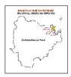
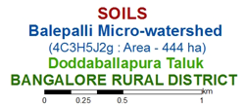
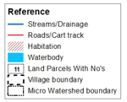
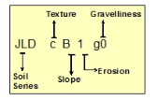
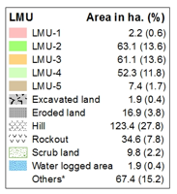
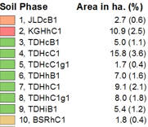
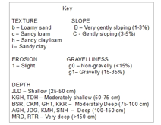
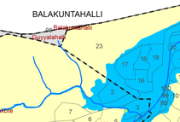
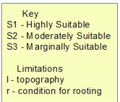
Physical, Cultural and Scientific symbols used in the Atlas
Each map in the atlas is complemented with physical, cultural and scientific symbols to facilitate easy map reading.
Inset map
Inset provided in each map conveys its strategic location i.e. Taluk, Sub-watershed and Micro-watershed.
Map title
Map title conveys the relevance of thematic information presented along with a graphical scale, geographical location and watershed details in text form.
Legends and symbols
Two legends accompany each map, a map reference, which depicts geographic features and a thematic legend which portrays spatial information. Picking up the symbol and colour of a particular unit enables one to choose the legends to obtain the required information.
Soil Units
The soil map may be read at different levels. The most detailed level is that of the soil phase. Soil phases are distinguished within soil series mainly based on differences in surface of soil texture, slope, erosion, gravelliness, etc.
Map colours
Different shades of colours are used as an aid to distinguish the different classes of soils, crop suitability and other maps.
Land Management Units (LMU)
Grouping of similar soil areas based on their soil-site characteristics into management units that respond similarly for a given level of management are designated as land management units.
Map key
There are many thematic types to be differentiated on the map solely based on colour. Therefore soils and suitability types and their limitations are distinguished by colours with a combination of alpha-numeric characters.
Soil and plot boundaries
Soil units shown on the map are represented by both the color and a numeral. The soil boundaries are superimposed on land parcel with revenue survey number boundaries to visualize its spatial extent.

Slide 6
Land resource inventory of Balepalli micro-watershed, Doddaballapura Taluk, Bangalore Rural district for Micro watershed planning-A study by UAS, Bangalore
Introduction
Soil and water are the two precious natural resources which are essential for crop production and existence of life on earth. Rainfed agriculture is under severe stress due to various constraints related to agriculture like uneven and erratic distribution of rainfall, indiscriminate use of fertilizers, chemicals and pesticides, adoption of improper land and crop management practices, soil erosion, decline in soil fertility and ground water resources leading to low crop productivity.
The area under rainfed agriculture has to be managed effectively using the best available practices to enhance the production of food, fodder and fuel. This is possible if the land resources are characterized at each parcel of land through detailed land resource inventory using the best available techniques of remote sensing, Global Positioning System (GPS) and Geographic Information System (GIS).
The watershed development programs are aimed at the sustainable distribution of its resources and the process of creating and implementing plans, programs, and projects to sustain and enhance watershed functions that would affect the plant, animal and human communities within a watershed boundary.
An appropriate Natural Resources Management (NRM) plan has been prepared. It is essential to assist in the planning for future land use, particularly agriculture, because it assesses the land resource and its potential for sustainable agricultural production. Land Resource Inventory (LRI) has been carried out based on five physical factors viz., rock, soil, slope, erosion type & severity and vegetation, which is the basis of assessing land resources. LRI helps in grouping together areas where similar land resources exists on ground, which would require the same kind of management and intensity of conservation treatment and same kind of crops, pasture or forestry species with similar yield potentials.
Bangalore rural district is located in the South-Eastern part of the State, lies between the Latitudinal parallels of 12⁰ 15’ North and 13⁰ 31’ North and the Longitudinal parallels of 77⁰ 04’ East and 77⁰ 59’ East with an area of 5814 km². The district is bounded by Kolar and Tumkur district in the north, Mandya district on the west, Chamarajanagar district on the south and towards southeast by Tamil Nadu state. This portion constituting Doddaballapura taluk is almost surrounded on North by Tumkur, South by Bangalore Urban, North-East by Kolar and South-West by districts. The main crops grown in the district are Paddy, jowar, Bajra, Maize, Wheat pulses oilseeds like groundnut, sunflower vegetables fruits and cash crop like sugarcane and others.

Slide 7
The University of Agricultural Sciences, Bangalore carried out land resource inventory of Balepalli micro-watershed, Balepalli sub-watershed in Doddaballapura Taluk, Bangalore Rural district. It was selected for data base generation under WDPD project. Balepalli micro-watershed (4C3H5J2g) is a part of Balepalli sub-watershed covering an area of 444 ha and spread across Mukkadigutta, Balakuntahalli, Kallukote, Hiremuddanahalli and Jakkalamadagu villages.
The major landforms identified in the micro-watershed are undulating uplands and mid lands. The database was generated by using cadastral map of the village as a base along with high resolution satellite imagery [Worldview2, 50 cm SR]
The objectives of the land resource inventory, carried out in Balepalli micro-watershed during 2022 are indicated below.
Detailed characterization of all the land resources like soil, water, land use, cropping pattern and other resources available at parcel level in the village
Delineation of homogenous areas based on soil-site characteristics into management units
Collection and interpretation of climatic and agronomical data for crop planning
Identification of problems and potentials of the area and strategies for their management
Assessment of the suitability of land resources for various crops and other uses
Establishment of village level digital land resources database in a GIS framework
Enable the watershed and other line departments to prepare an action plan for the integrated development of the watershed

Slide 8
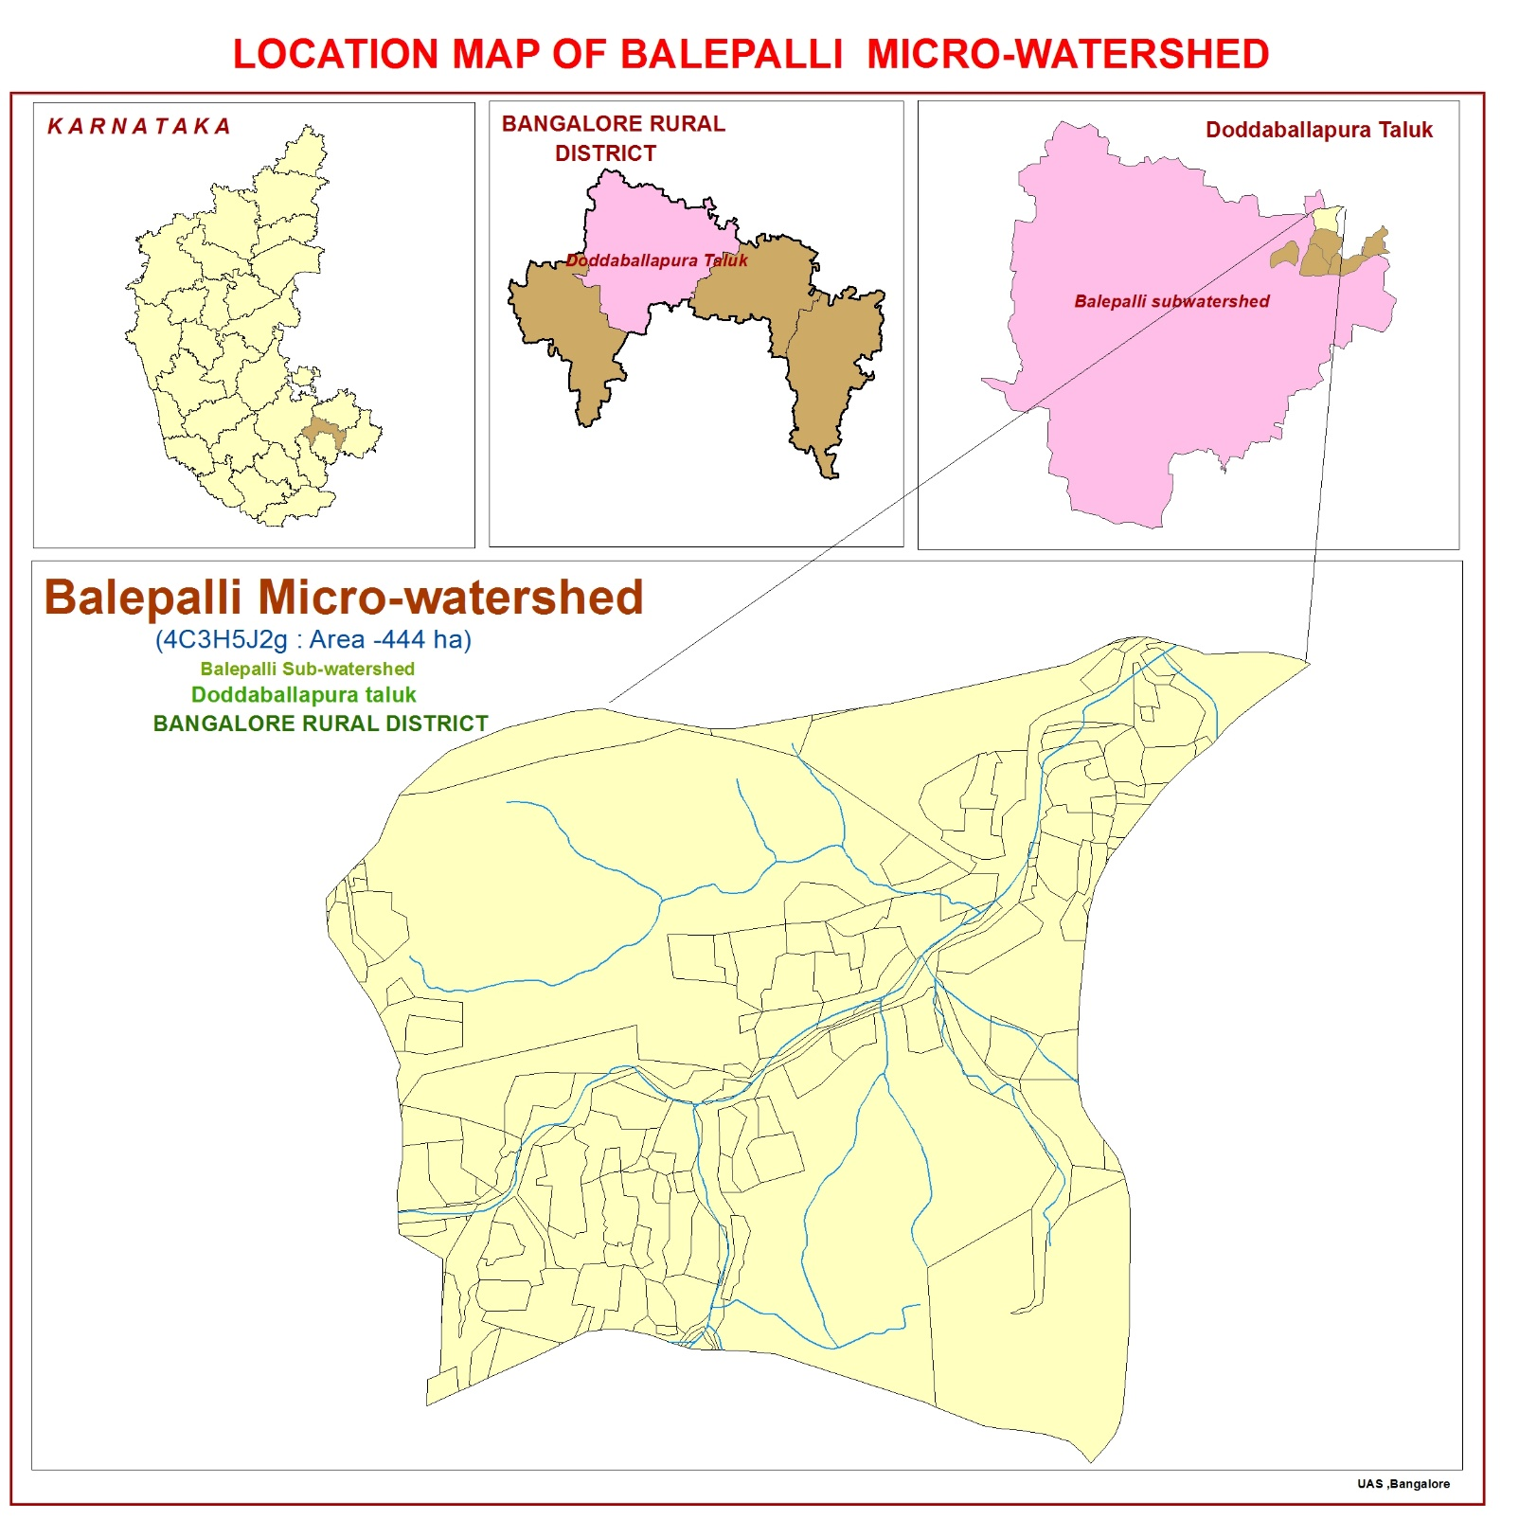
General description of the area
Location and Extent
Balepalli micro-watershed (Balepalli sub-watershed, Doddaballapura Taluk, Bangalore Rural District) is located at North latitude 13⁰ 23’ 8.85” to 13⁰ 25’ 39.88” and East longitude 77⁰ 32’ 3.05” to 77⁰ 33’ 4.55” covering an area of 444 ha and spread across Mukkadigutta, Balakuntahalli, Kallukote, Hiremuddanahalli and Jakkalamadagu villages.
Agro Ecological Sub Region (AESR) 8.2:
The micro-watershed is located in Central Karnataka plateau, hot, moist, semi-arid eco-sub region, Southern Plateau and Hill Region.
Agro-climatic Zone 5: Eastern Dry Zone
The total geographical area of the agro-climatic zone (4) is about 1.808 M ha comprising of 5 districts (Bangalore rural, Tumkur, Ramanagara, Chikkaballapura and Kolar). The average annual rainfall ranges from 679.1- 888.9 mm of which more than 50 per cent is received during the Kharif season. The elevation is 800-900 m. The major soils are red loamy and remaining areas are lateritic. The main crops are Ragi, Paddy, Pulses, Maize and Oil seeds.

Slide 9
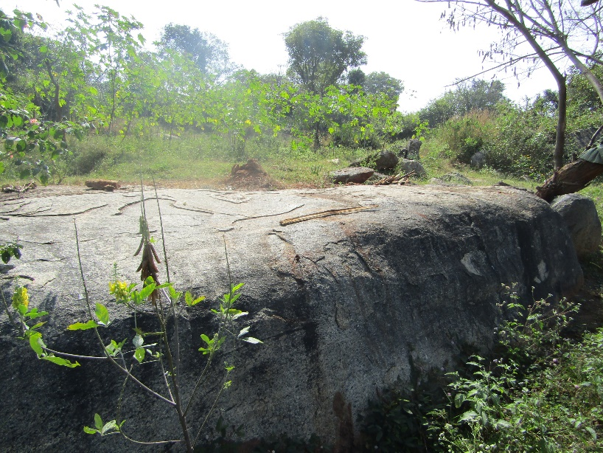
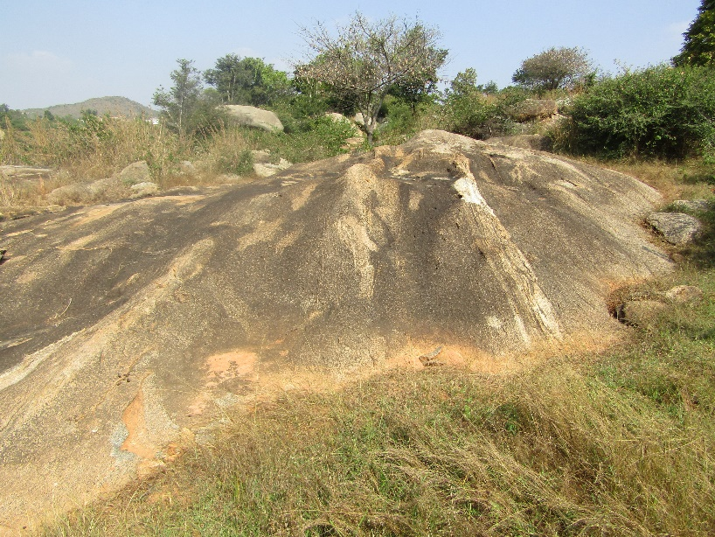
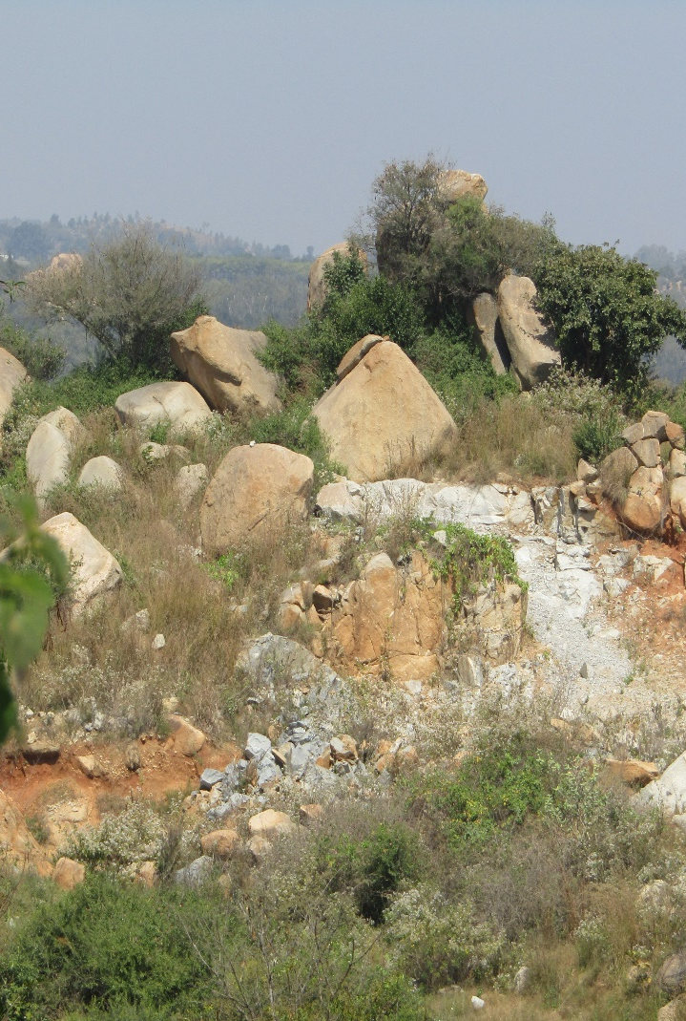
Geology
Geology - Karnataka state
The geology of Karnataka lay widespread in 5 major ereas, viz., the Archean, Proterozoic, Mesozoic and the Ceonzoic. The geology of Karnataka is largely confined to the two oldest eras; the Archean and the Proterozic. The rest of the great periods from Cambian to recent are hardly represented but for minor sediments of recent age exposed along the coastal margin to the West. A substantial part of North Karnataka is covered by Deccan trap, representing phenomenal outburst of volcanic activity at the dawn of the Cenozoic era.
Exposure of Granitic Gneiss in Balepalli sub watershed
Geology – Bangalore Rural [Arechean Complex]
Geology of the Bangalore rural district is broadly described under two groups (i) the dominating Archaean crystalline formation comprising peninsular gneissic complex with a small patch of hornblende schist in the northern part and intrusive close pet granite all along the western part of the district (ii) smaller stretches of unconsolidated sediments. The granite gneisses are mainly of magmatitic type, highly banded in composition from granite to diorite. Physio-graphically the district can be divided into rocky upland, plateau and flat-topped hills at an elevation of about 900 m MSL. Flat-topped Laterite hills are seen in the northern part at an elevation of 900 m MSL. The Pediplains form major part of the district underlying gneisses and granites with the highest Pediplain in the range of 850 m and 950 m MSL. Rocky upland Pediplain and plateau constitutes erosional topography. Major part of the Pediplain is dissected by streamlets flowing in southern direction. In northern part of Doddaballapura taluk, area is covered with uplands by gneisses and granites, which are ideal for agriculture. The major rock formations in Chikkaballapura taluk are the Laterites ,Granites & Gneissic granites. The eastern portion is mainly composed of laterites and gneissic granites where as the hilly terrain forming the western portion of the taluk is composed of coarse grained granites. These formations are intruded by dolerite dykes and pegmatite veins.
Exposure of Granitic Gneiss in
Balepalli sub watershed
5

Slide 10
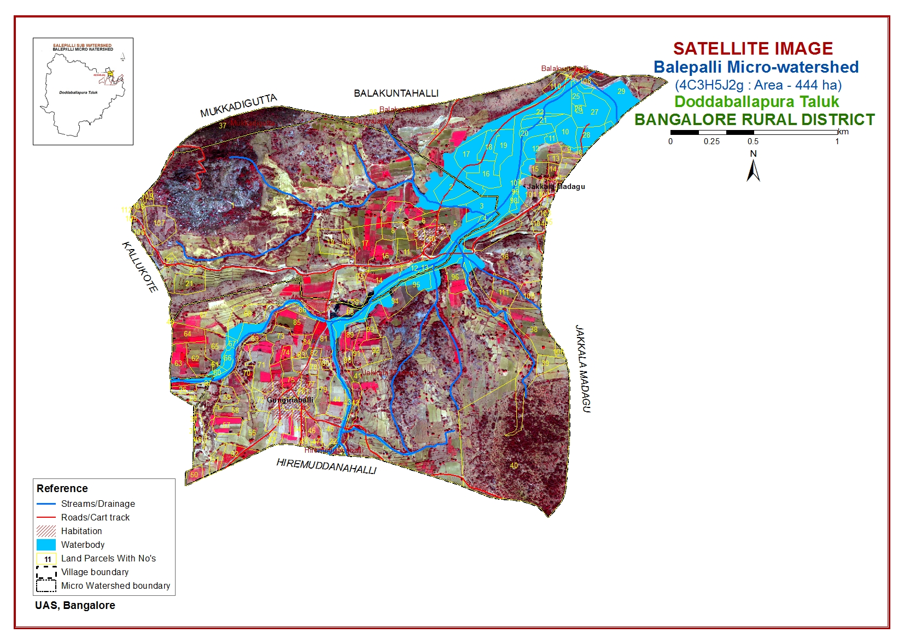

Slide 11
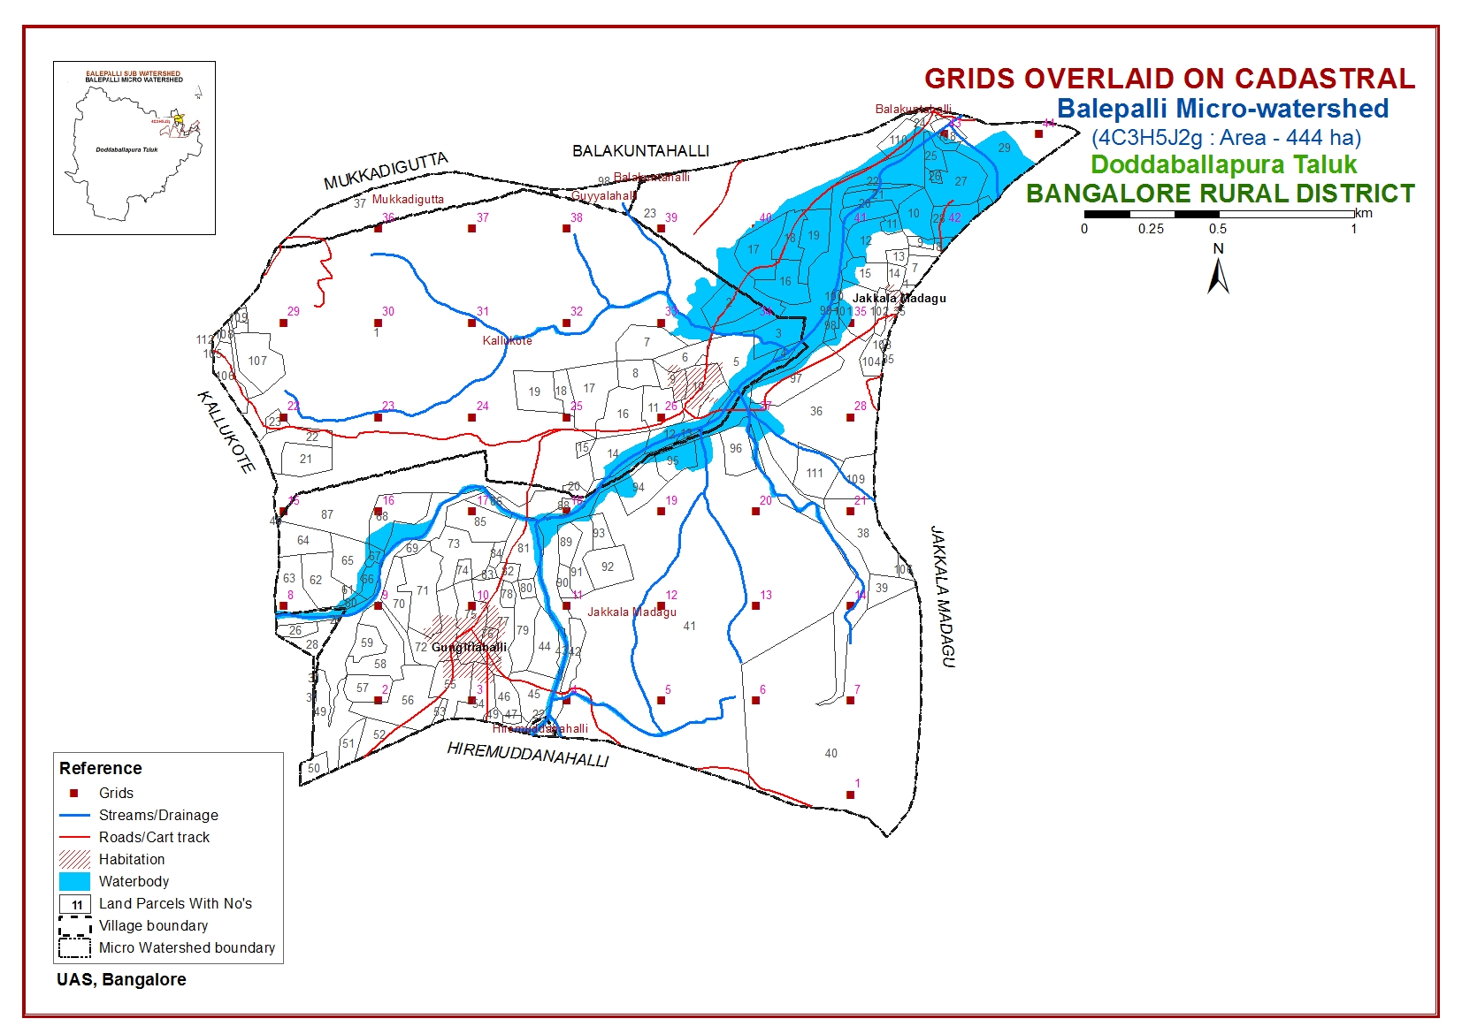

Slide 12
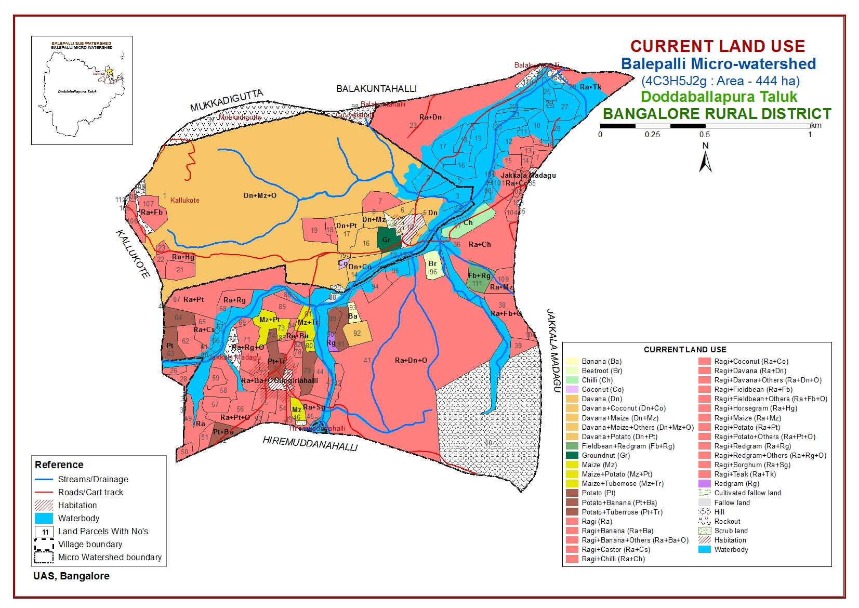

Slide 13
Survey Methodology
Sequence of activities leading to Land Resource Inventory (LRI)
Traversing the watershed using cadastral maps and imagery as base
Identifying landforms, geology, land use and other features
Selecting fields representing land units
Opening profiles up to 2 m depth
Studying soil and site characteristics
Grouping similar areas based on their soil-site characteristics into land management units
Preparation of crop, soil and water conservation plan
The required site and soil characteristics are described and recorded on a standard proforma by following the protocols and guidelines given in the soil survey manual and field guide. Collection of soil samples from representative pedons for laboratory characterization and collection of surface soil samples at 320 m grid intervals from selected fields covering most of the management units for macro and micro-nutrient analysis has been carried out. Further, processing of data at analytical and GIS lab were carried out to generate various thematic maps for each of the study area.

Slide 14
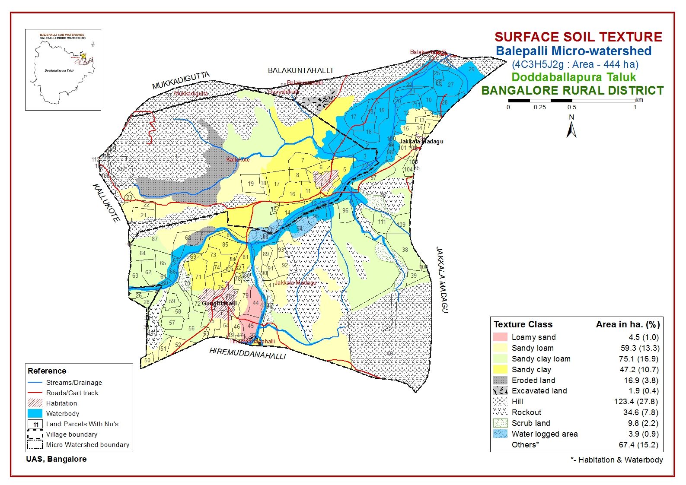
SOIL SURVEY INTERPRETATIONS

Slide 15
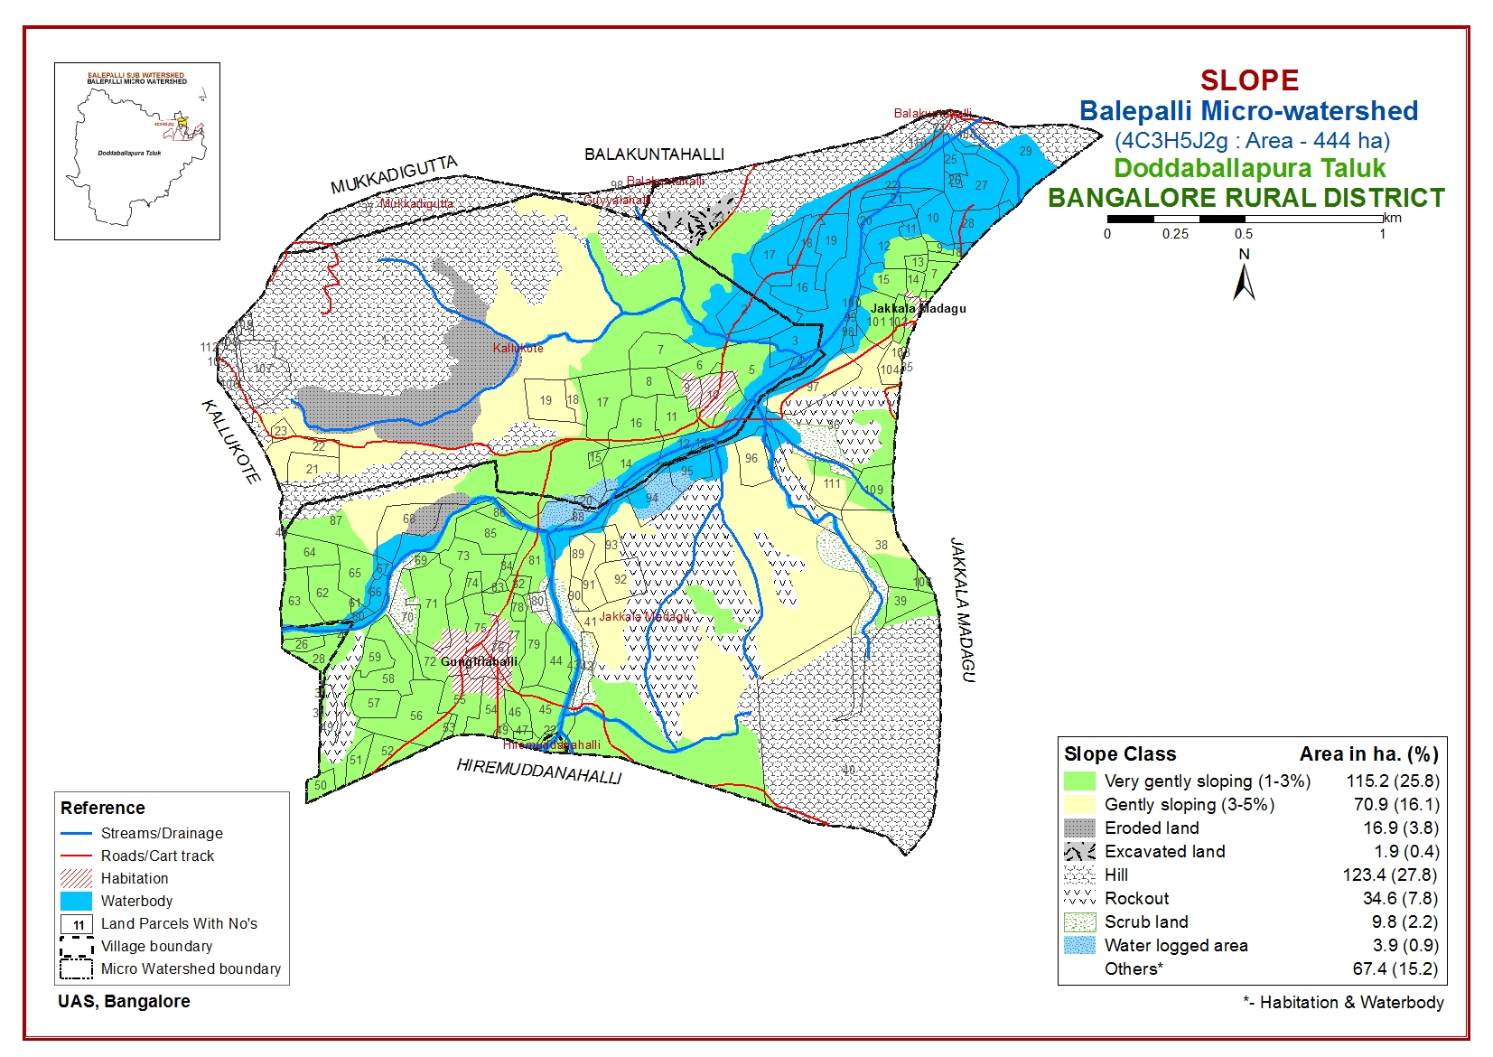

Slide 16
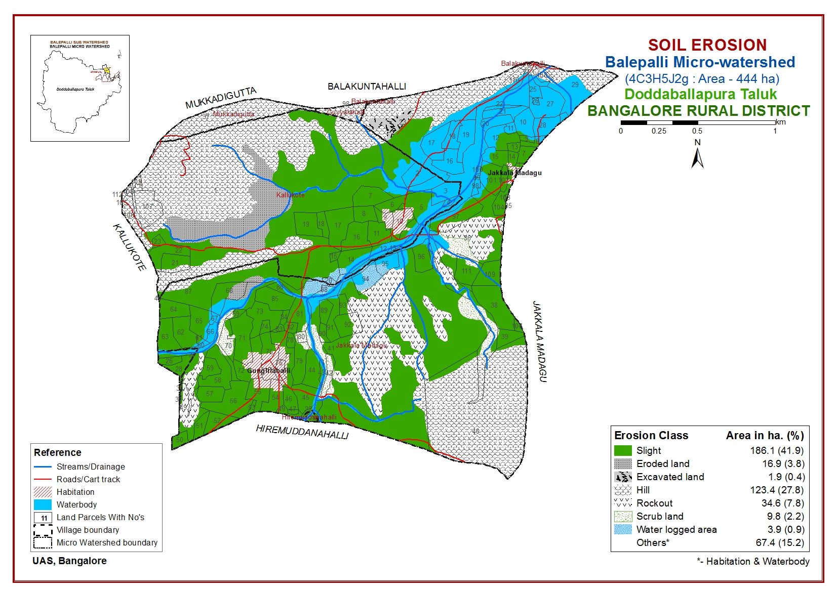

Slide 17
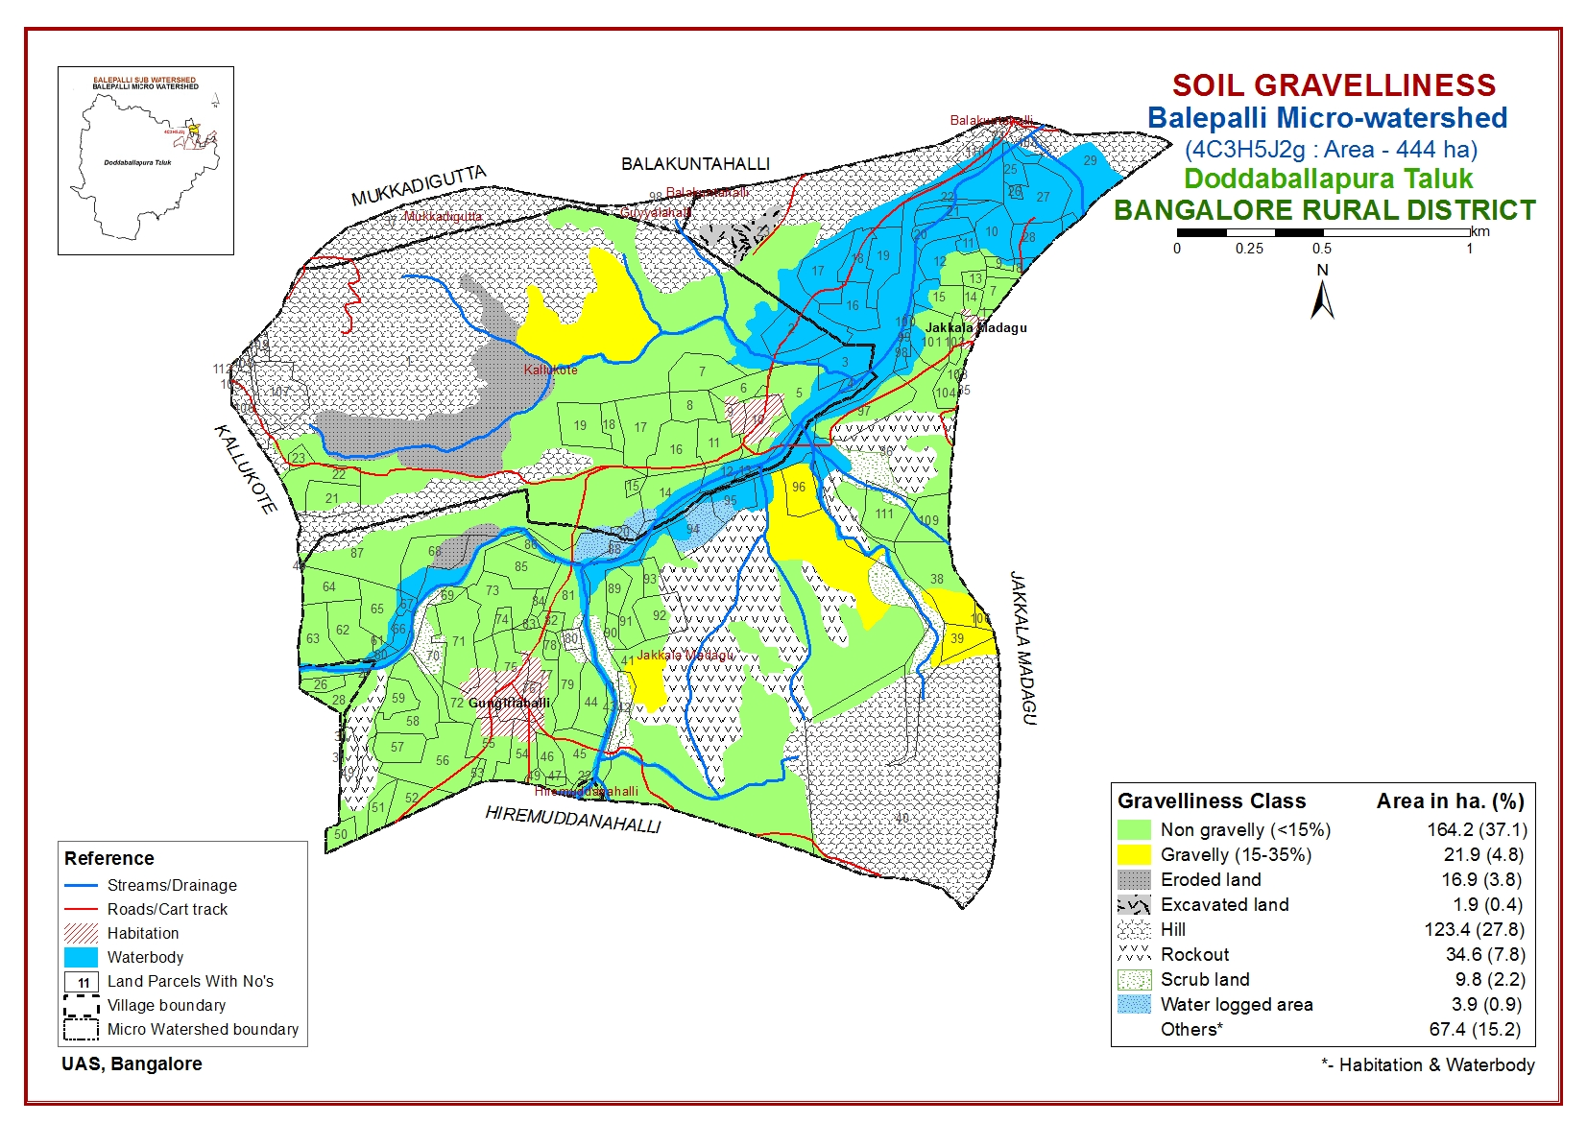

Slide 18
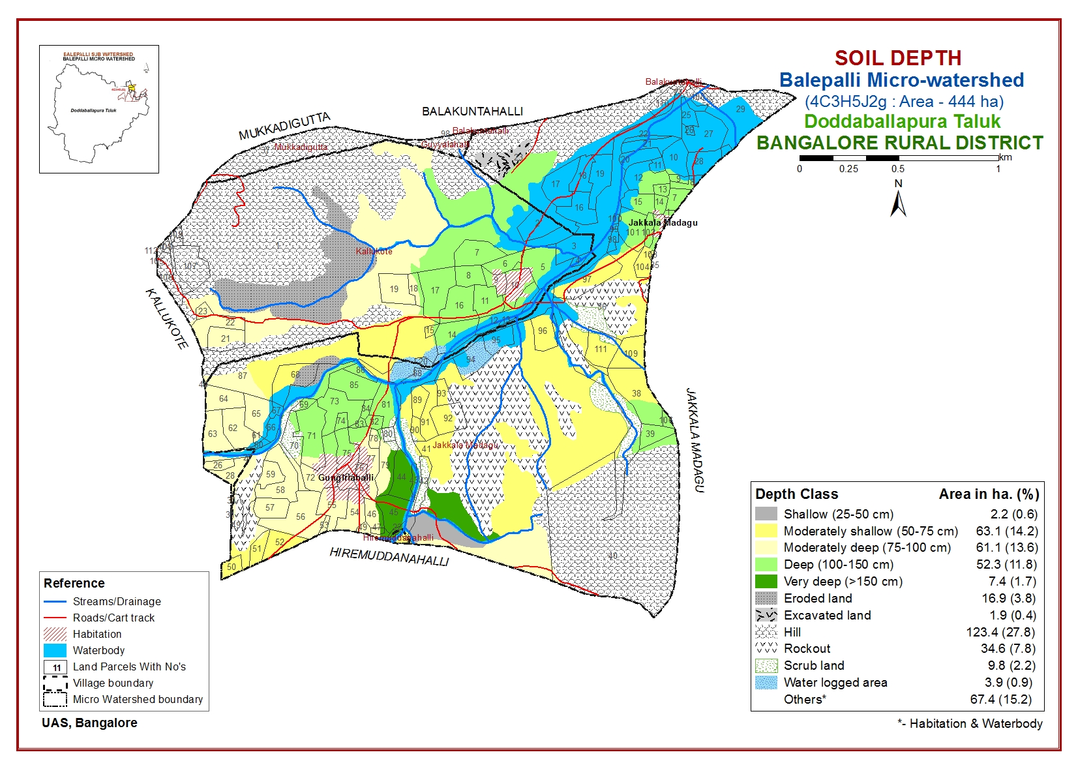

Slide 19
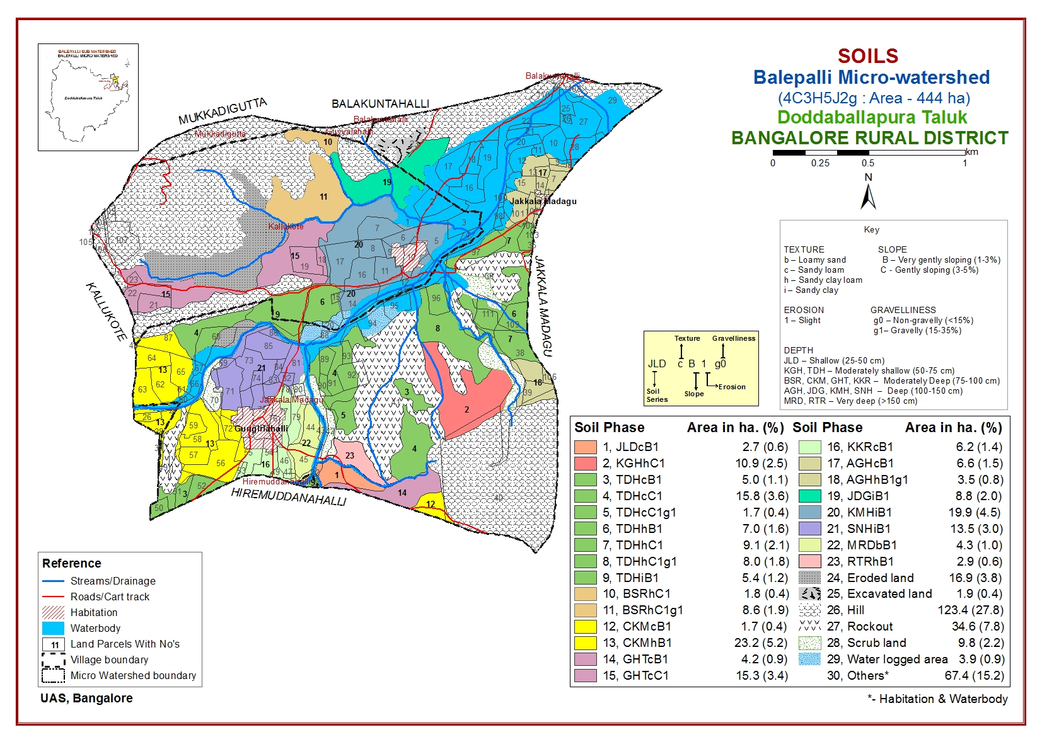

Slide 20
Mapping unit description of Balepalli Micro-watershed, Doddaballapur Taluk, Bangalore Rural district
The soils of the micro-watershed area were developed from granite and granite gneiss
Soil Phase | Phase description | Area (ha)
JLDcB1 | Shallow depth (25-50 cm), sandy loam, occurring on very gently sloping lands, slope 1-3 per cent with slight erosion | 2.7
KGHhC1 | Moderately shallow depth (50-75 cm), sandy clay loam, occurring on gently sloping lands, slope 3-5 per cent with slight erosion | 10.9
TDHcB1 | Moderately shallow depth (50-75 cm), sandy loam, occurring on very gently sloping lands, slope 1-3 per cent with slight erosion | 5.0
TDHcC1 | Moderately shallow depth (50-75 cm), sandy loam, occurring on gently sloping lands, slope 3-5 per cent with slight erosion | 15.8
TDHcC1g1 | Moderately shallow depth (50-75 cm), sandy loam, occurring on gently sloping lands, slope 3-5 per cent with slight erosion with 15-35 per cent gravels | 1.7
TDHhB1 | Moderately shallow depth (50-75 cm), sandy clay loam, occurring on very gently sloping lands, slope 1-3 per cent with slight erosion | 7.0
TDHhC1 | Moderately shallow (50-75 cm), sandy clay loam, occurring on gently sloping lands, slope 3-5 per cent with slight erosion | 9.1
TDHhC1g1 | Moderately shallow (50-75 cm), sandy clay loam, occurring on gently sloping lands, slope 3-5 per cent with slight erosion with 15-35 per cent gravels | 8.0
TDHiB1 | Moderately shallow (50-75 cm), sandy clay, occurring on very gently sloping lands, slope 1-3 per cent with slight erosion | 5.4
BSRhC1 | Moderately deep (75-100 cm), sandy clay loam, occurring on gently sloping lands, slope 3-5 per cent with slight erosion | 1.8
BSRhC1g1 | Moderately deep (75-100 cm), sandy clay loam, occurring on gently sloping lands, slope 3-5 per cent with slight erosion with 15-35 per cent gravels | 8.6
CKMcB1 | Moderately deep (75-100 cm), sandy loam, occurring on very gently sloping lands, slope 1-3 per cent with slight erosion | 1.7
To be continued

Slide 21
Soil Phase | Phase description | Area (ha)
CKMhB1 | Moderately deep (75-100 cm), sand clay loam, occurring on very gently sloping lands, slope 1-3 per cent with slight erosion | 23.2
GHTcB1 | Moderately deep (75-100 cm), sandy loam, occurring on very gently sloping lands, slope 1-3 per cent with slight erosion | 4.2
GHTcC1 | Moderately deep (75-100 cm), sandy loam, occurring on gently sloping lands, slope 3-5 per cent with slight erosion | 15.3
KKRcB1 | Moderately deep (75-100 cm), sandy loam, occurring on very gently sloping lands, slope 1-3 per cent with slight erosion | 6.2
AGHcB1 | Deep (100-150 cm), sandy loam, occurring on very gently sloping lands, slope 1-3 per cent with slight erosion | 6.6
AGHhB1g1 | Deep (100-150 cm), sandy clay loam, occurring on very gently sloping lands, slope 1-3 per cent with slight erosion with 15-35 per cent gravels | 3.5
JDGiB1 | Deep (100-150 cm), sandy clay, occurring on very gently sloping lands, slope 1-3 per cent with slight erosion | 8.8
KMHiB1 | Deep (100-150 cm), sandy clay, occurring on very gently sloping lands, slope 1-3 per cent with slight erosion | 19.9
SNHiB1 | Deep (100-150 cm), sandy clay, occurring on very gently sloping lands, slope 1-3 per cent with slight erosion | 13.5
MRDbB1 | Very deep (>150 cm), loamy sand, occurring on very gently sloping lands, slope 1-3 per cent with slight erosion | 4.3
RTRhB1 | Very deep (>150 cm), sandy clay loam, occurring on very gently sloping lands, slope 1-3 per cent with slight erosion | 2.9
Eroded land |  | 16.9
To be continued

Slide 22
Soil Phase | Phase description | Area (ha)
Excavated land |  | 1.9
Hill |  | 123.4
Rockout |  | 34.6
Scrub land |  | 9.8
Water logged area |  | 3.9
Others |  | 67.4
Total |  | 444

Slide 23
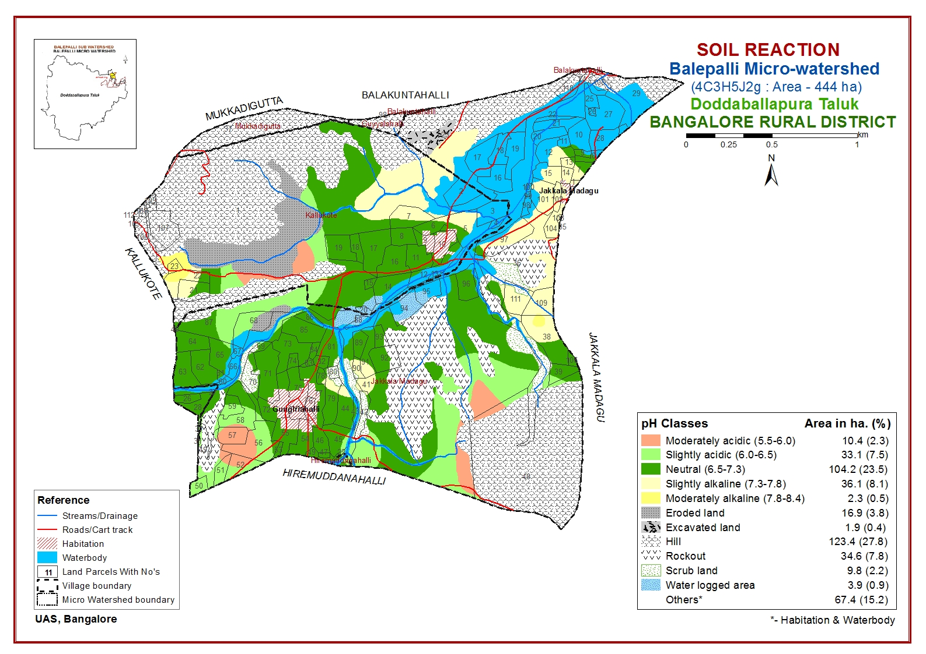
SOIL FERTILITY STATUS

Slide 24
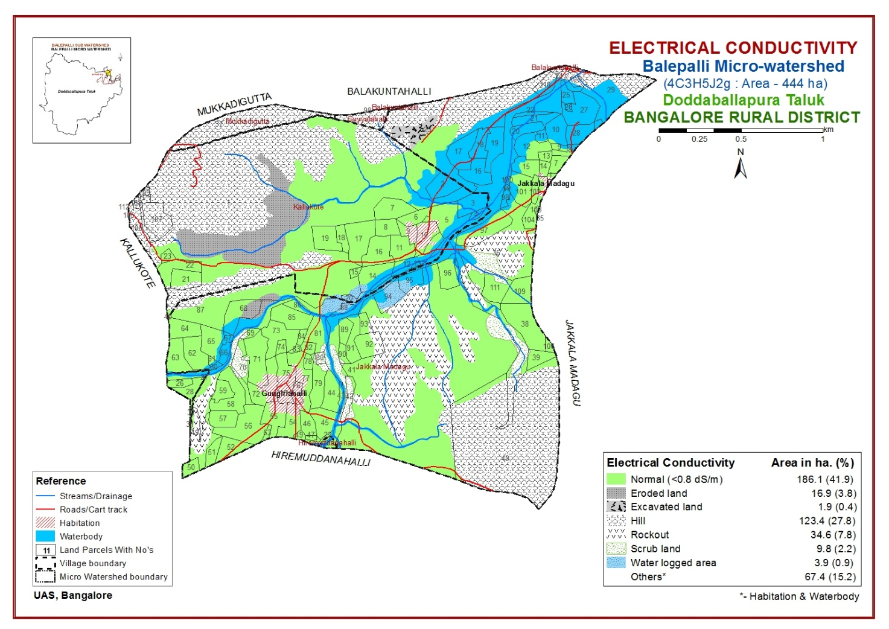
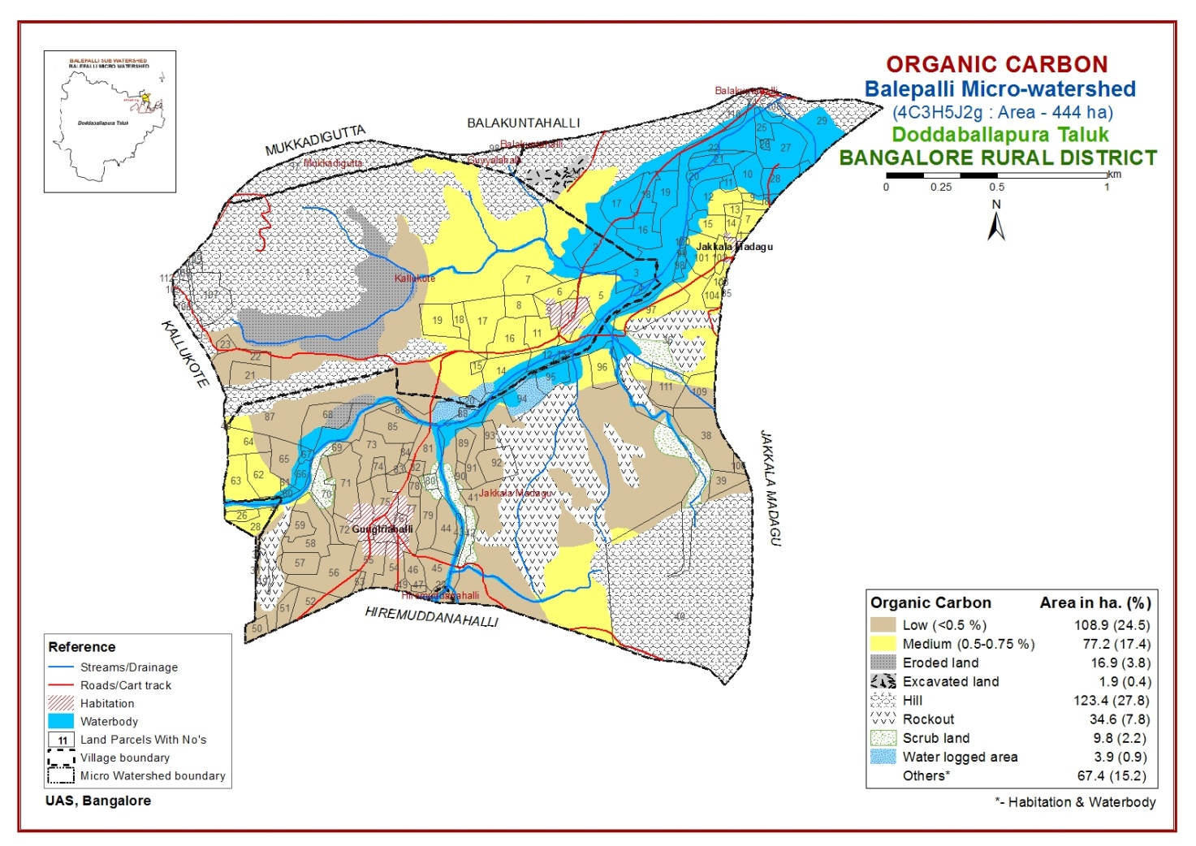
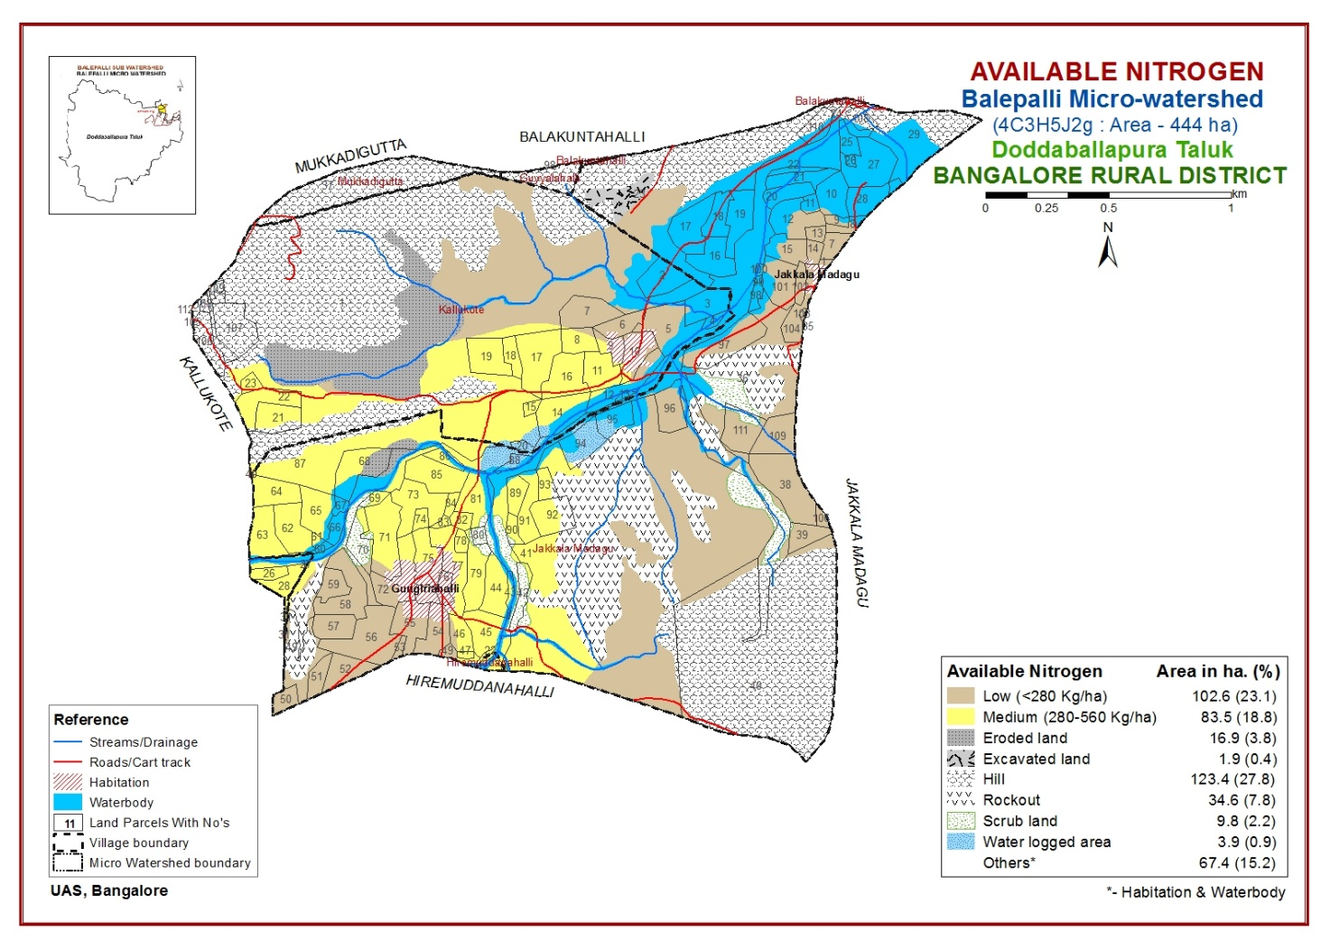
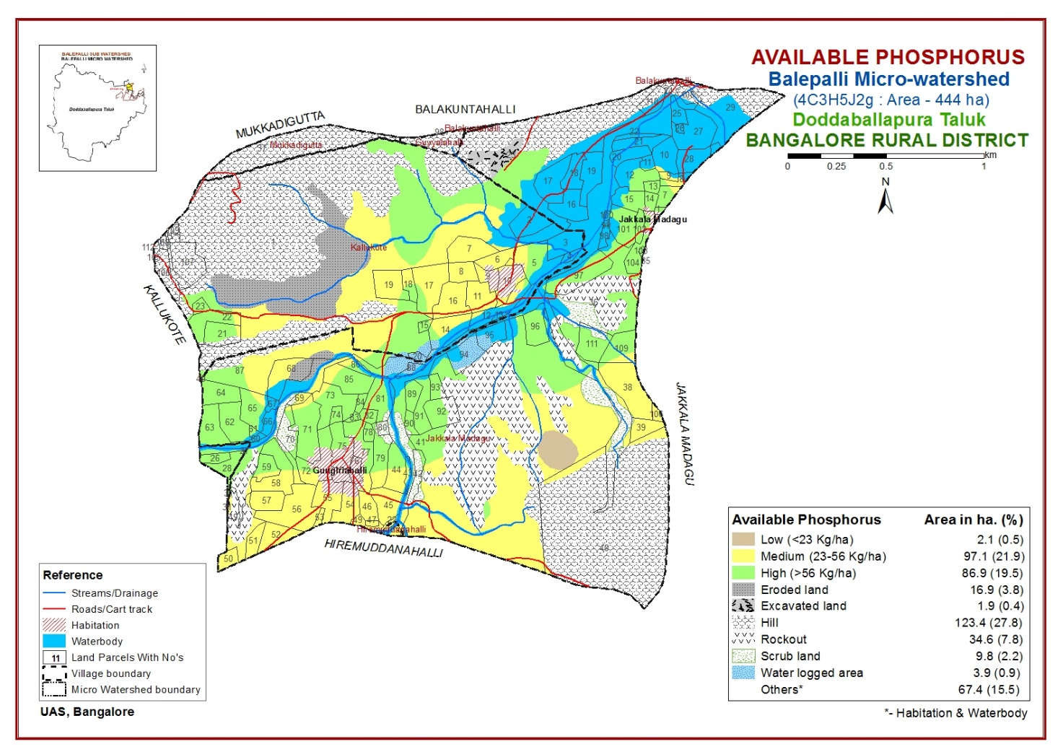

Slide 25
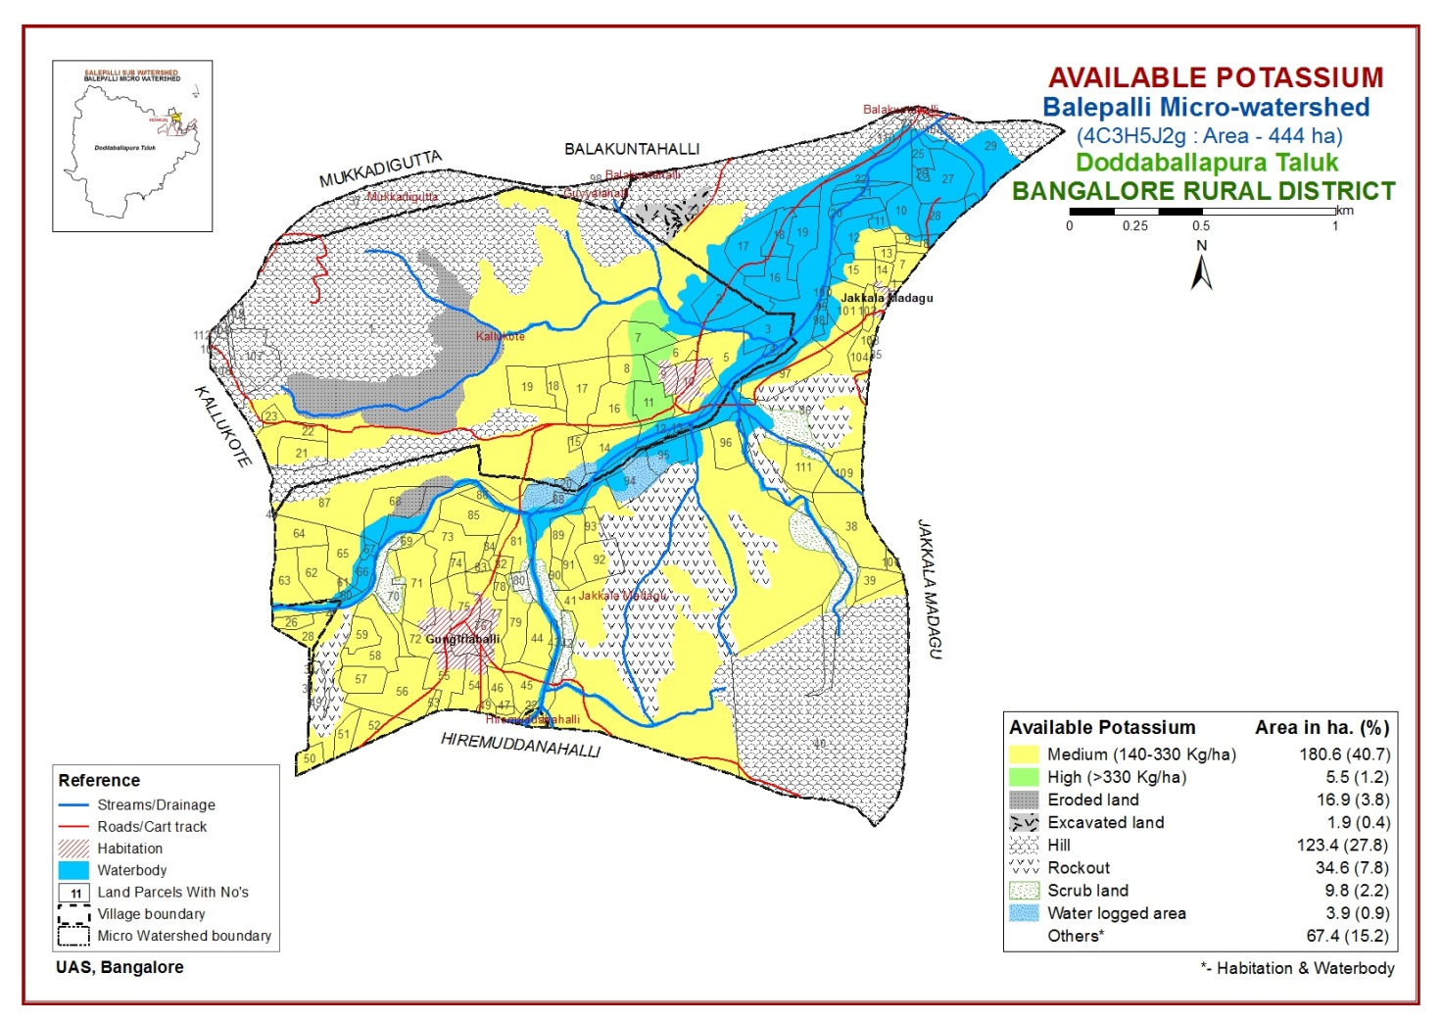

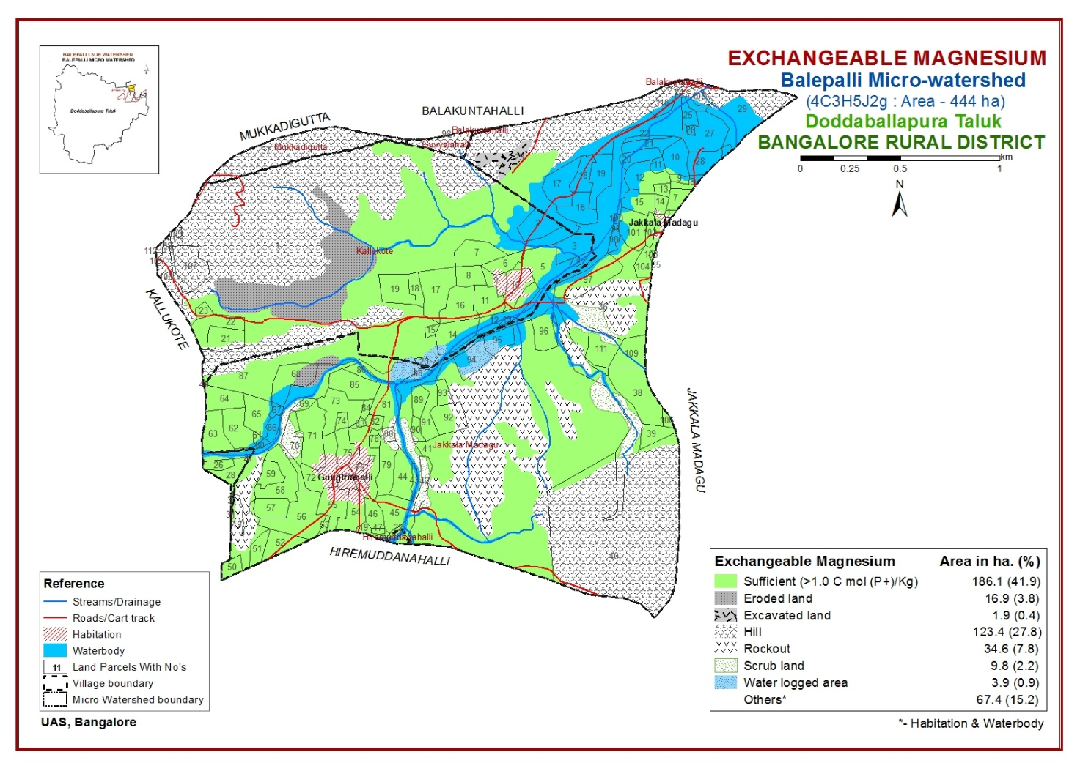

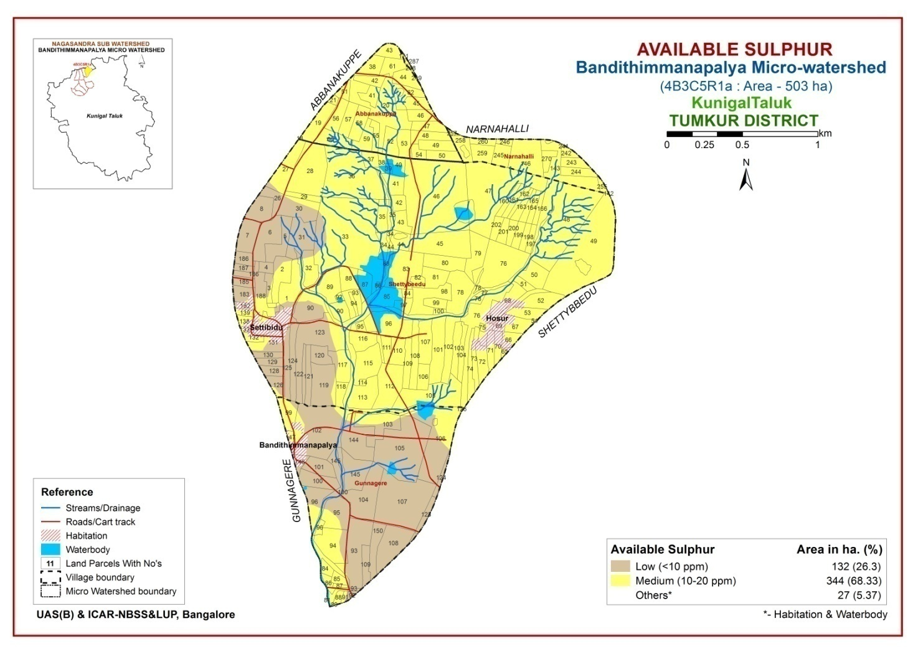

Slide 26
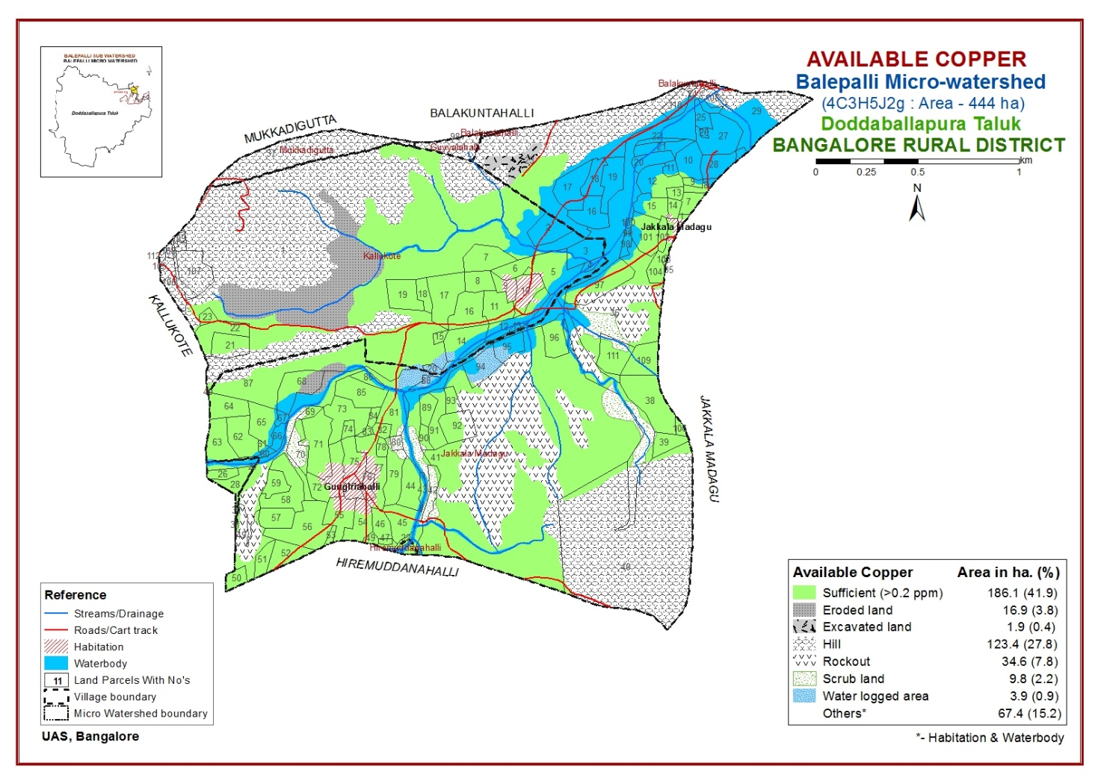


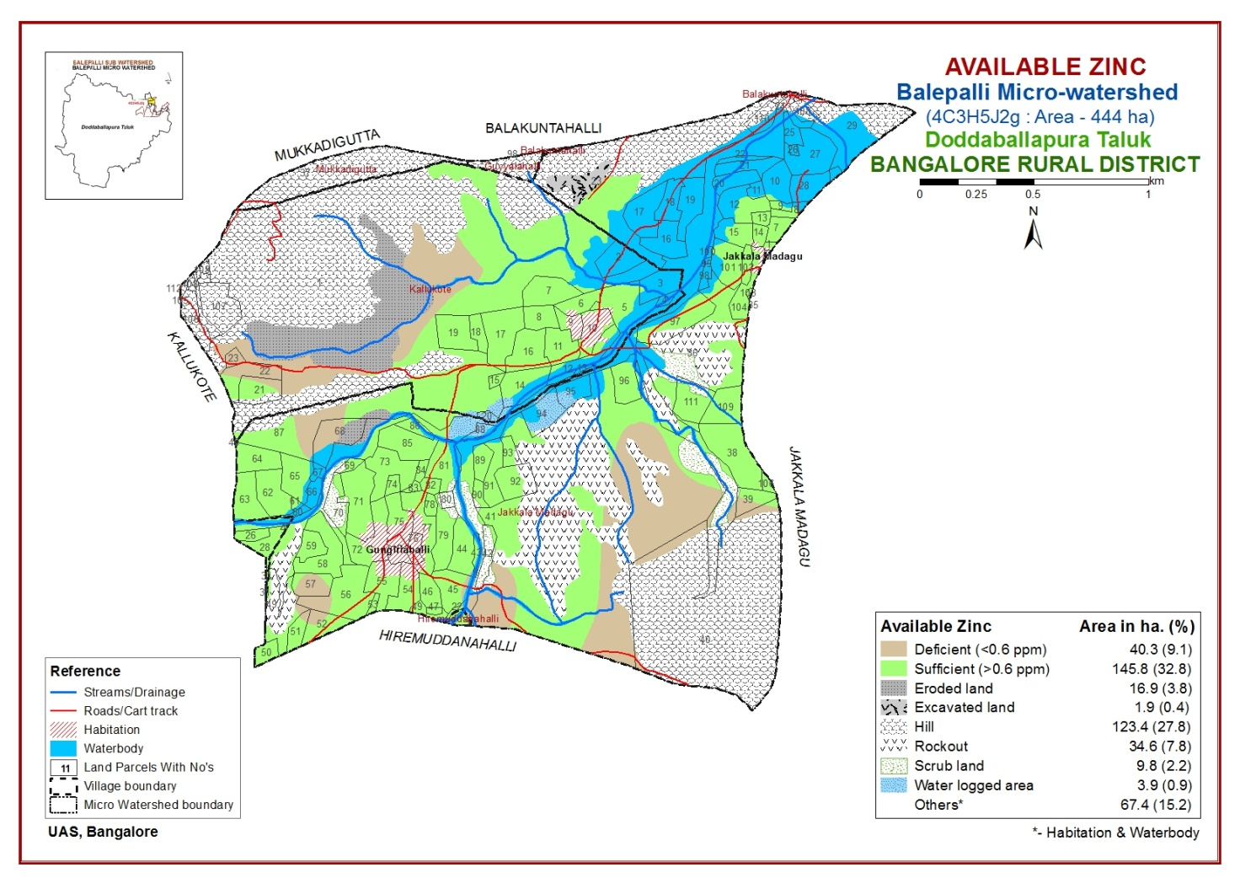

Slide 27
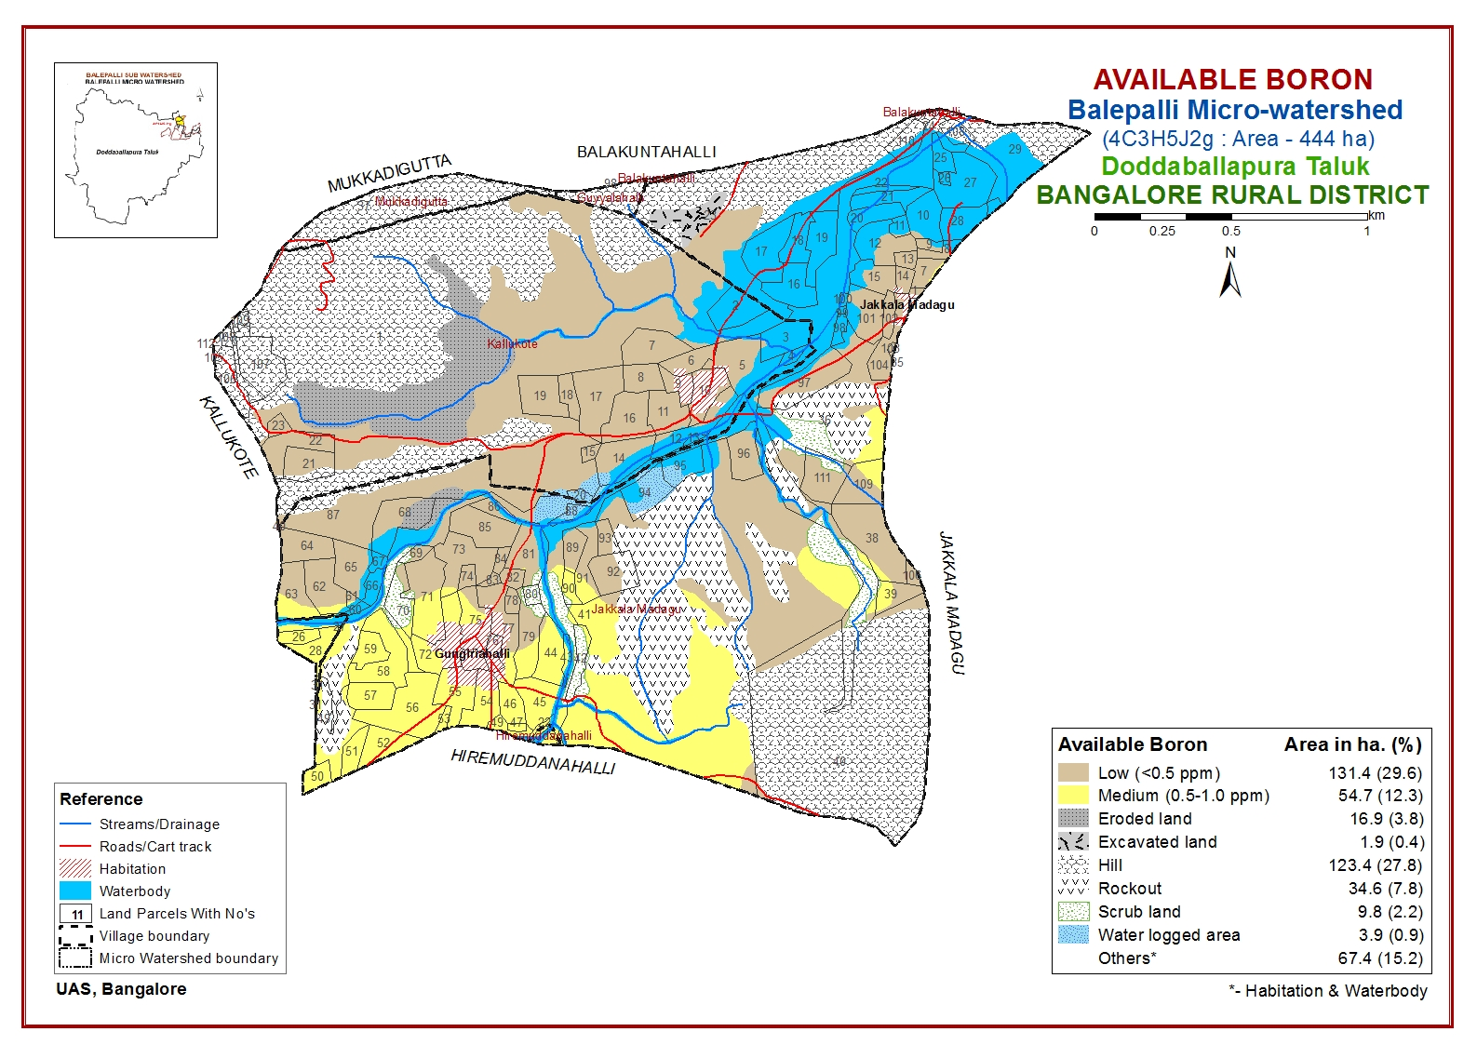

Slide 28
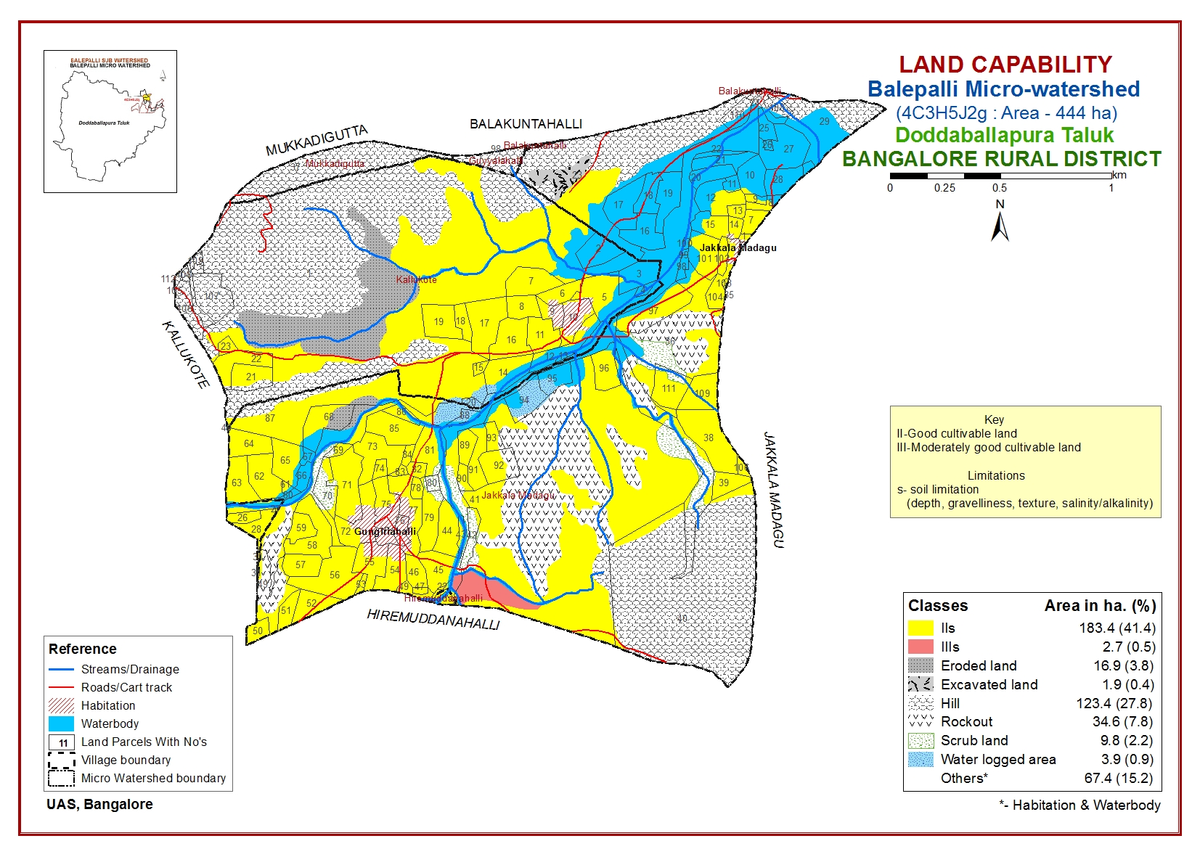

Slide 29
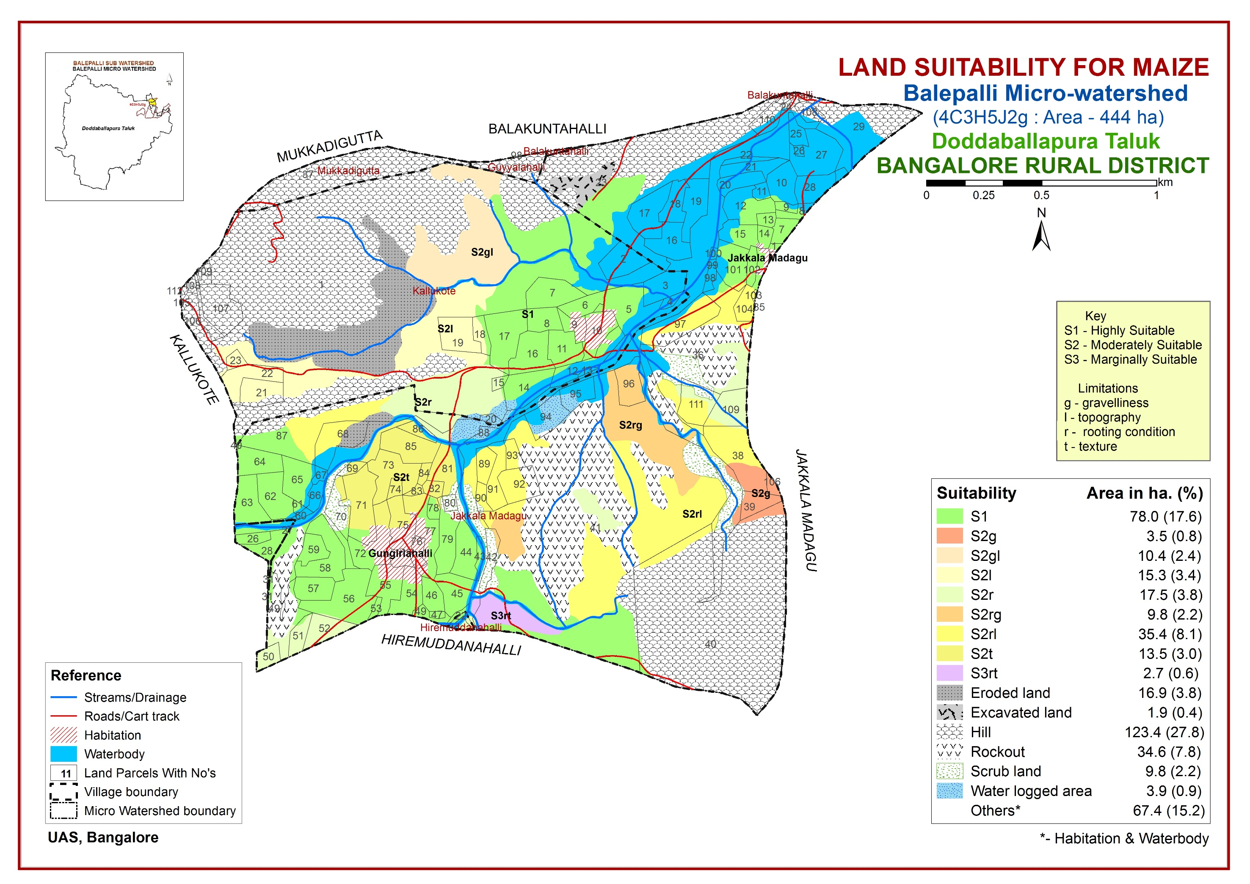
LAND SUITABILITY FOR AGRICULTURAL CROPS

Slide 30
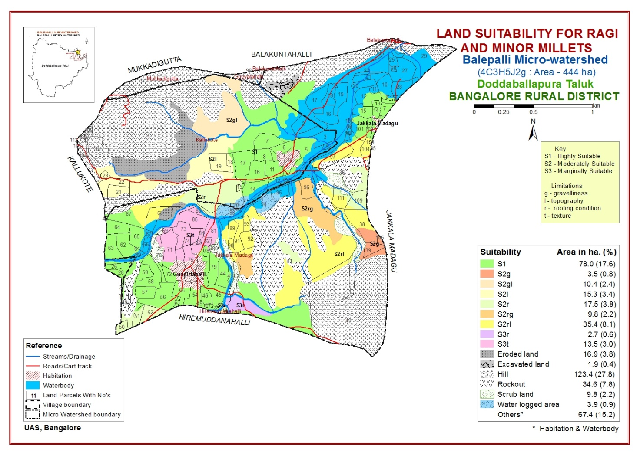
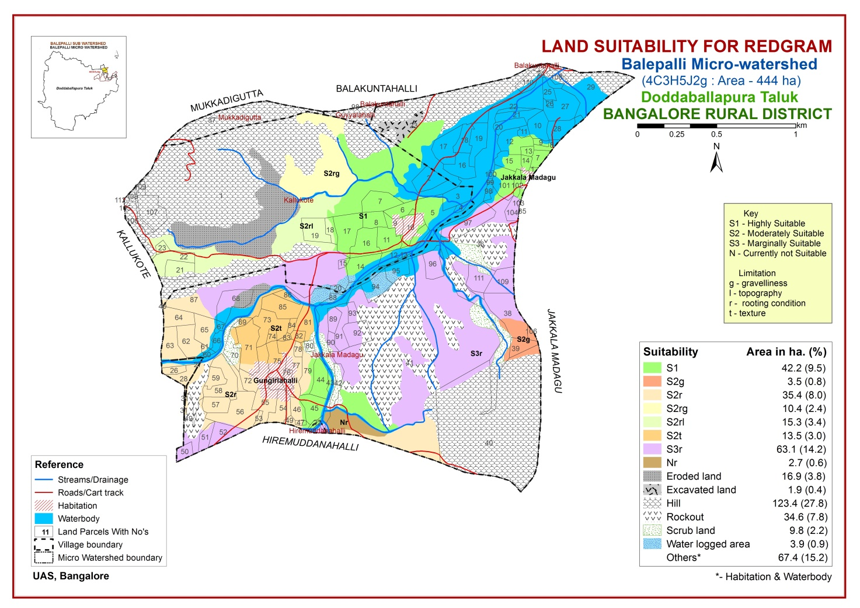
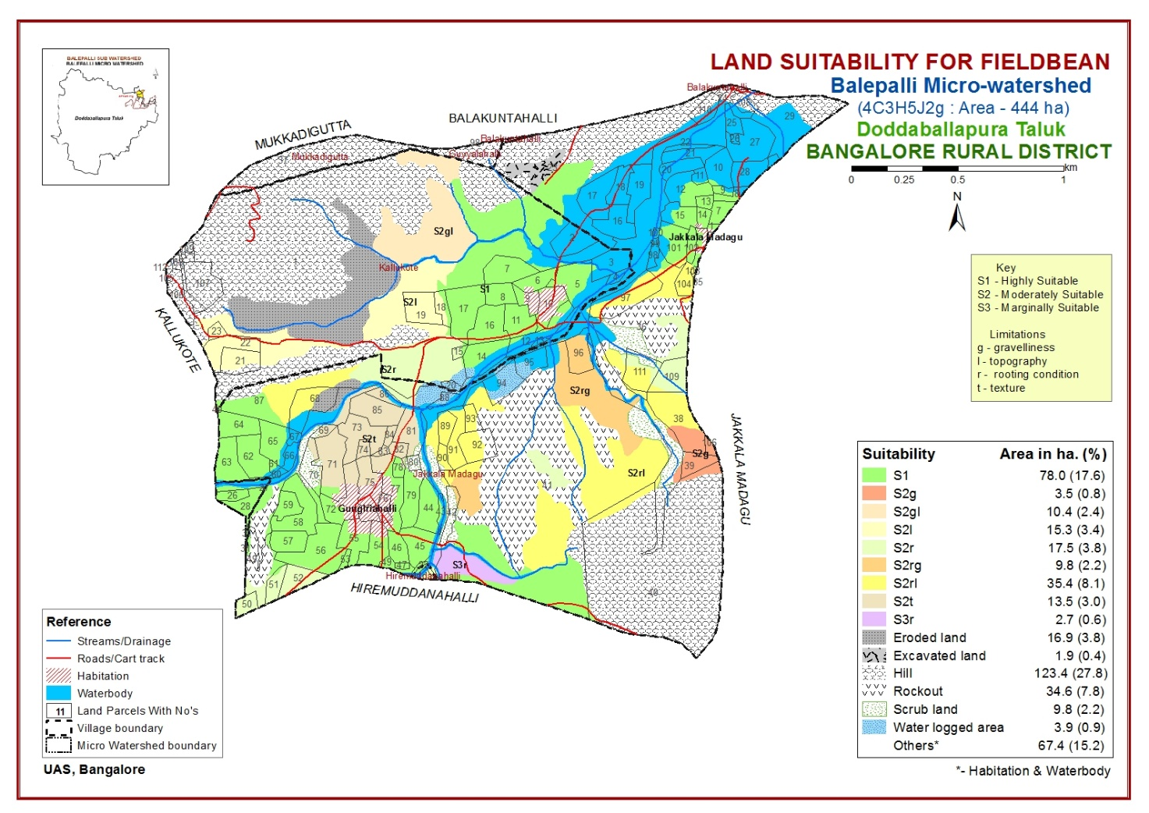
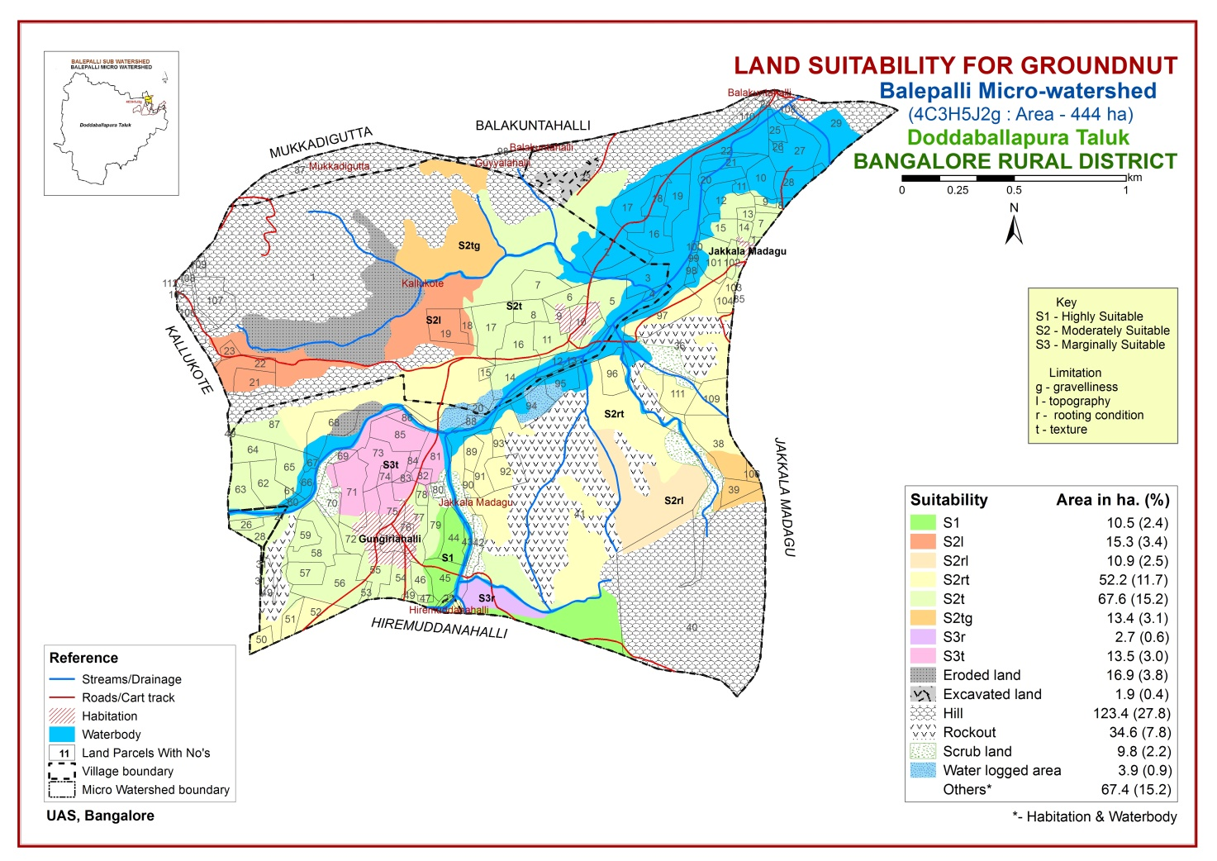

Slide 31
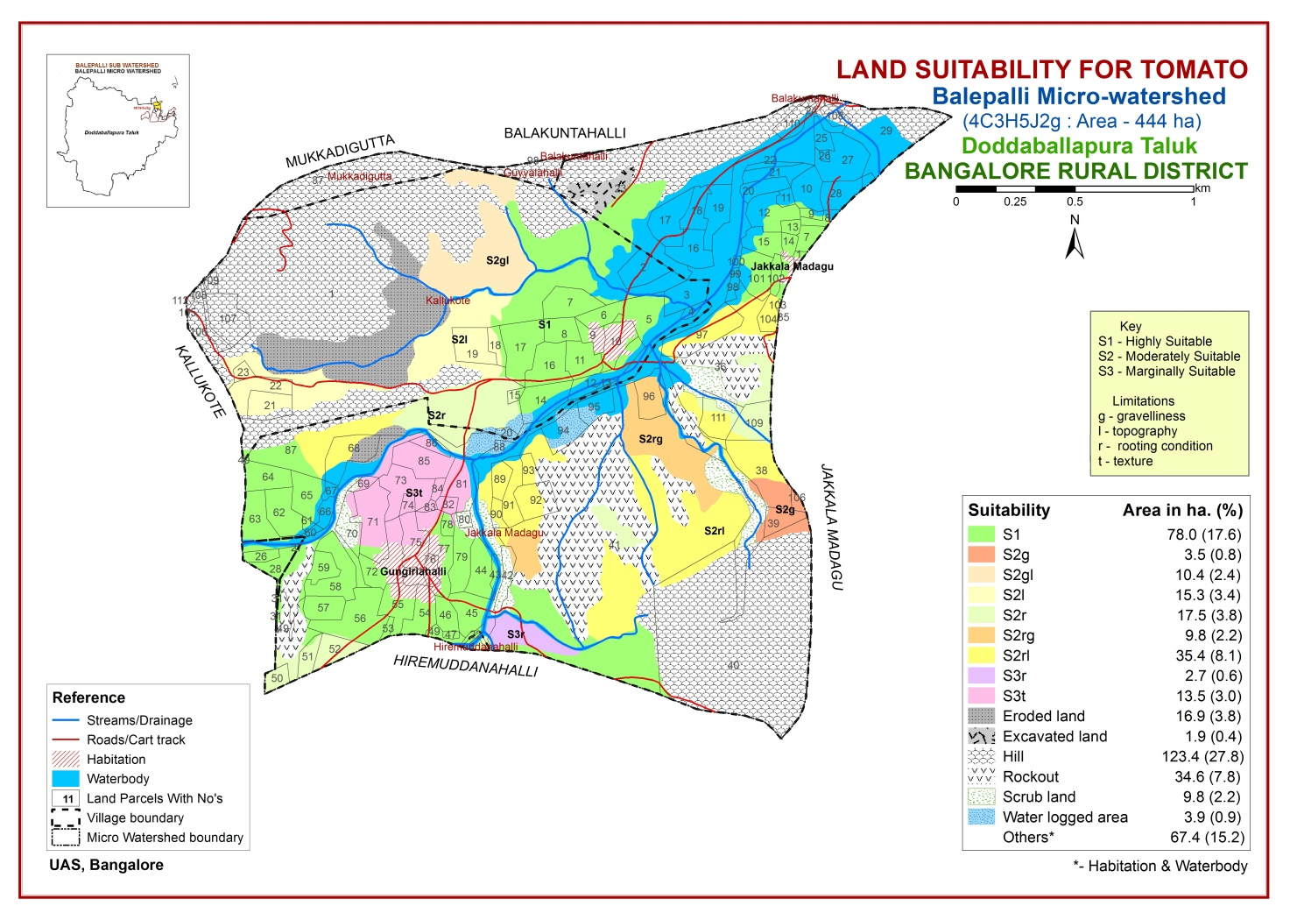


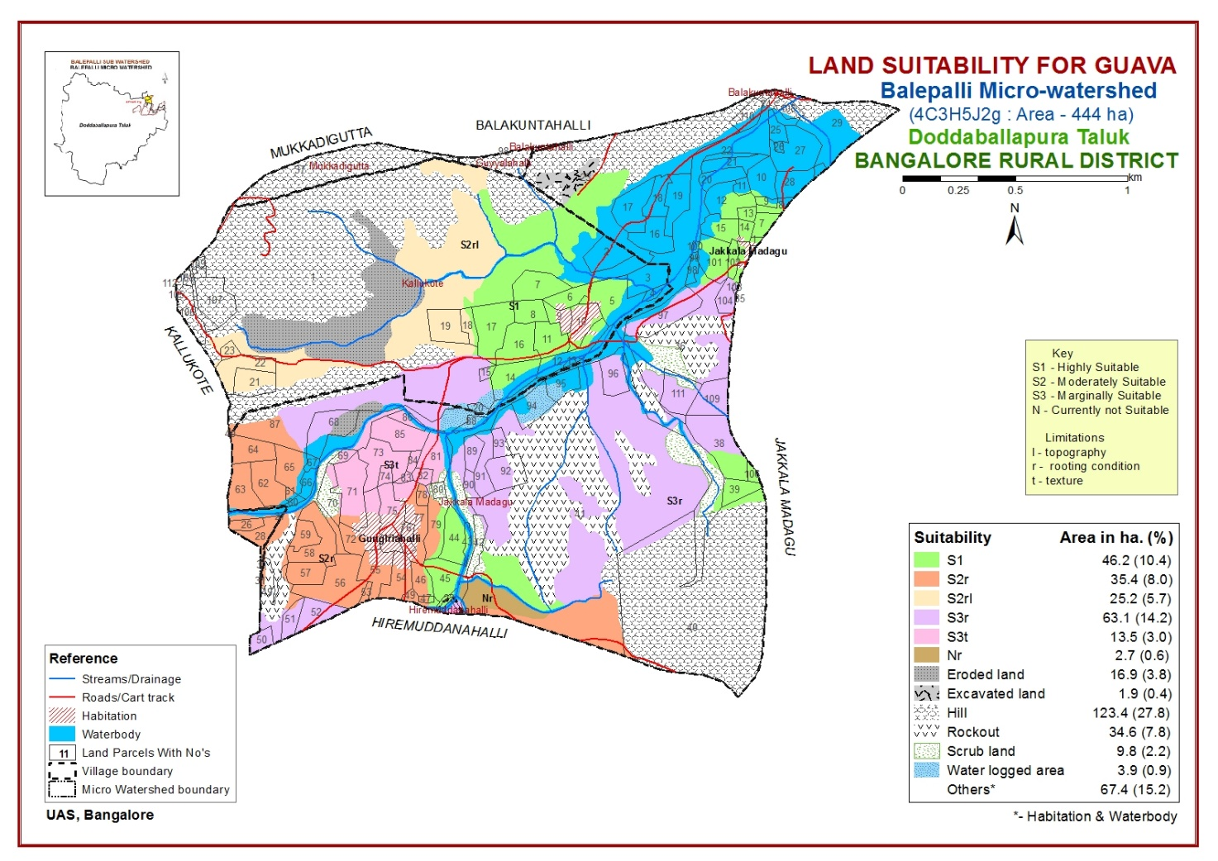
LAND SUITABILITY FOR HORTICULTURE CROPS

Slide 32

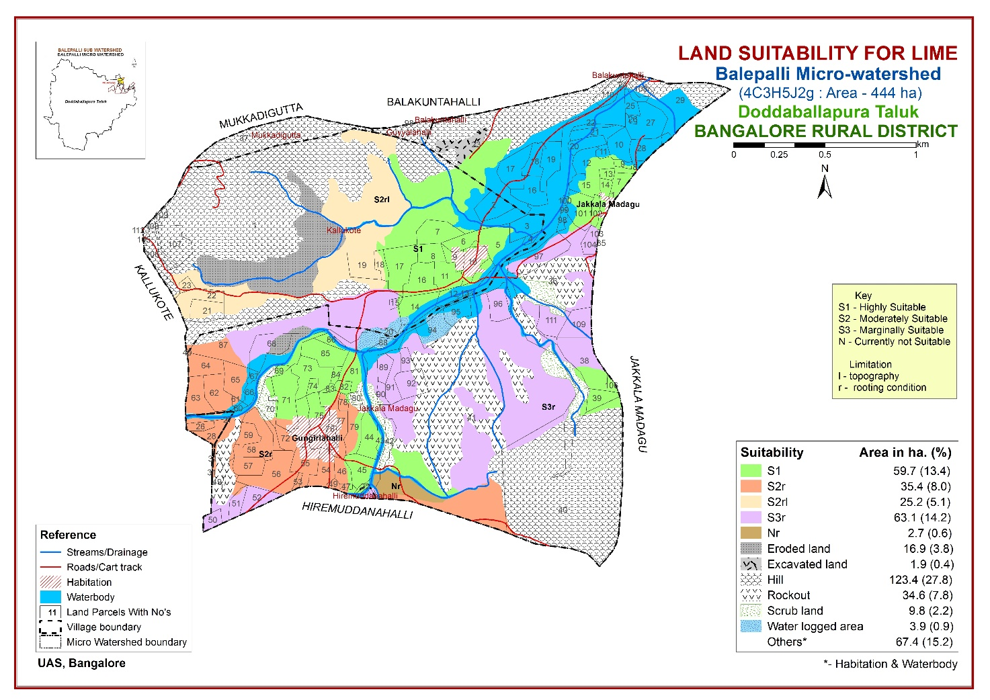
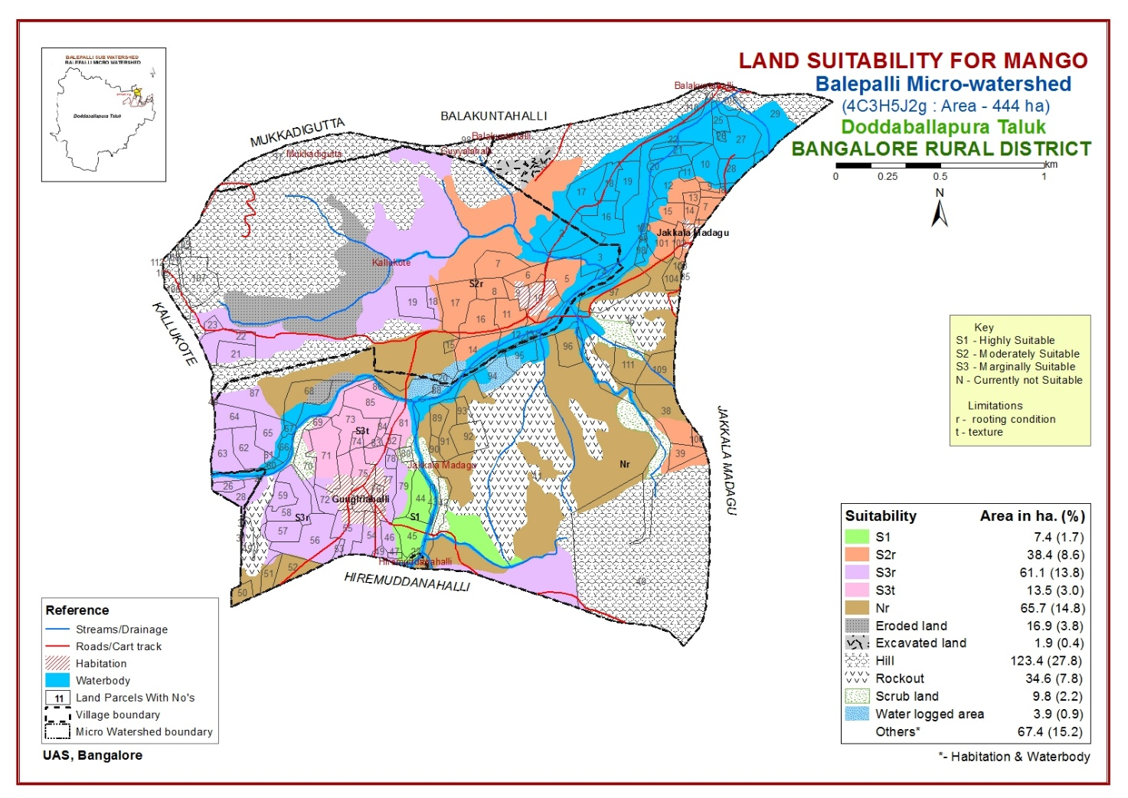


Slide 33

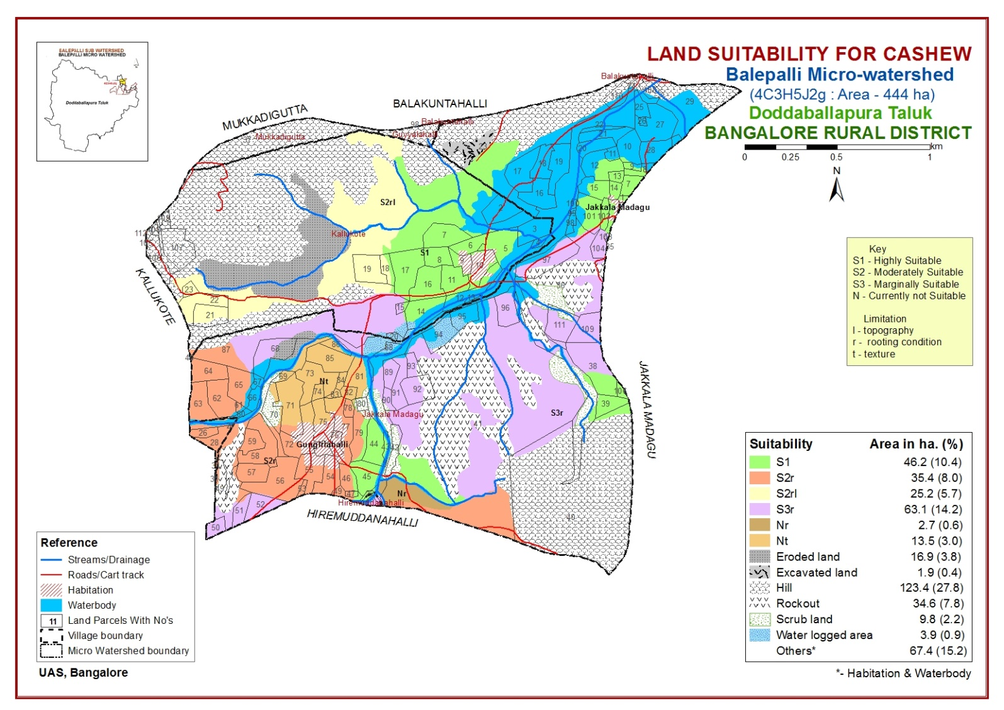

Slide 34
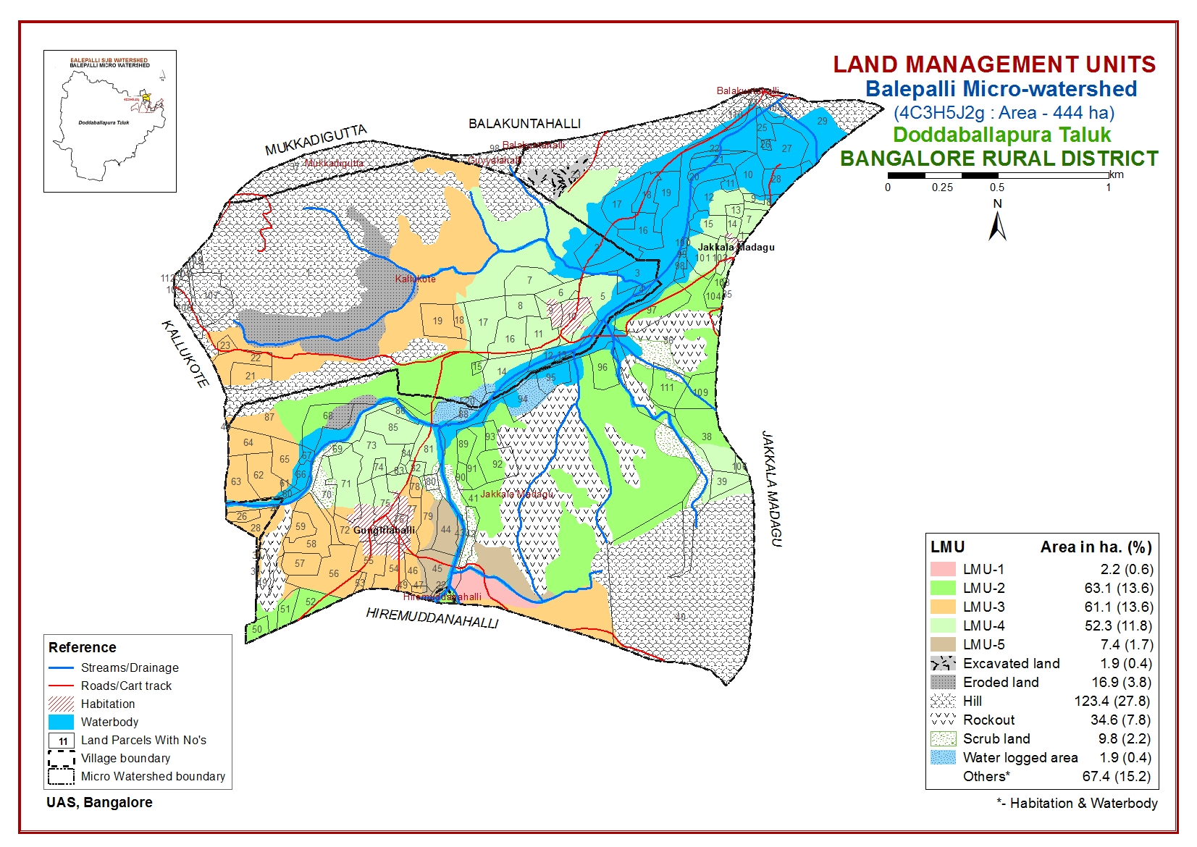

Slide 35
Proposed Crop Plan for Balepalli Micro-watershed based on soil-site–crop suitability assessment of Doddaballapura Taluk, Bangalore Rural District.
LMU No. | Mapping unit | Survey numbers | Characters | Field crops | Forestry crop/Grasses | Horticulture crops (Rainfed condition) | Horticulture crops with suitable intervention | Suitable Intervention
LMU-1 | JLDcB1 | Jakkala Madagu- 41 | Shallow (25-50 cm), sandy loam, very gently sloping (1-3 %) with slight erosion | Sole crop: Ragi, Minor millets, Horsegram | Grasses: Styloxanthes hamata, | - | Vegetable Crops: Chilli, Field bean | Application of tank silt to light textured soil and organic manures, sowing across the slope, use of short duration and drought resistant varieties, application of Nitrogen fertilizer in split dose.
LMU-2 | KGHhC1 TDHcB1 TDHcC1 TDHcC1g1 TDHhB1 TDHhC1 TDHhC1g1 TDHiB1 | Hiremuddanahalli- 22 Jakkala Madagu- 35, 36, 38, 40, 41, 42, 49-53, 56, 65, 68, 81, 86, 87, 89-94, 96, 97, 101-104, 109, 111 Kallukote- 1, 15, 17, 20 | Moderately shallow (50-75 cm), sandy loam to sandy clay very gently sloping (1-3 %) to gently sloping (3-5 %) with slight erosion and 15-35 per cent gravels in TDHcC1g1 and TDHhC1g1 mapping unit | Sole crop: Ragi, Minor millets and Groundnut Intercropping: Ragi + Cowpea (4:1), Ragi + Fieldbean (8:1) | Hebbevu Grasses: Styloxanthes hamata, Styloxanthes scabra, Hybrid napier, Fodder Sorghum | Fruit crops: Custard apple, Amla Vegetables: Curry Leaf | Vegetable Crops: Chilli, Tomato, Field bean | Application of organic manures, Land levelling without exposing the parent material and opening of dead furrow at 8-12 feet, use of short duration and drought resistant varieties, sowing across the slope, application of Nitrogen fertilizer in split dose.

Slide 36
LMU No. | Mapping unit | Survey numbers | Characters | Field crops | Forestry crop/Grasses | Horticulture crops (Rainfed condition) | Horticulture crops with suitable intervention | Suitable Intervention
LMU-3 | BSRhC1 BSRhC1g1 CKMcB1 GHTcB1 GHTcC1 | Guyalahalli-98 Jakkala Madagu- 40, 41, 45-47, 49, 51-65, 70-72, 77-79, 89 Kallukote- 1, 18, 19, 21-23, 26-28, 31, 40 Mukadigatta-37 | Moderately deep (75-100 cm), sandy loam and sandy clay loam, very gently sloping (1-3 %) to gently sloping (3-5 %) with slight erosion and 15-35 per cent gravels in BSRhC1g1 mapping unit | Sole crop: Ragi, Maize, Minor millets, Red gram and Groundnut Intercropping: Ragi + Cowpea (4:1), Ragi + Fieldbean (8:1) Ragi+Redgram (4:1) | Hebbevu Grasses: Styloxanthes hamata, Styloxanthes scabra, Hybrid napier, Fodder Sorghum | Fruit crops: Custard apple, Amla, Sapota, Guava, Lime Vegetables: Curry Leaf, Drumstick | Fruit/Plantation crops: Arecanut, Coconut, Jackfruit and Cashew Vegetable Crops: Chilli, Tomato, Field bean | Application of organic manures, land levelling and opening of dead furrow at 8-12 feet, sowing across the slope in ridge and furrow, application of Nitrogen fertilizer in split dose.
LMU-4 | AGHcB1 AGHhB1g1 JDGiB1 KMHiB1 SNHiB1 | Jakkala Madagu- 1, 7-15, 23, 36, 38-40, 70-75, 77-87, 100-104, 106 Kallukote- 1, 3, 5-12, 14-18 | Deep (100-150 cm), sandy loam to sandy clay, very gently sloping (1-3 %) with slight erosion and 15-35 per cent gravels in AGHhB1g1 mapping unit | Sole crop: *Ragi, Maize, *Minor millets, Red gram and *Groundnut Intercropping: Ragi + Cowpea (4:1), Ragi + Fieldbean (8:1) Ragi+Redgram (4:1) Groundnut+ Redgram (6:1) | Hebbevu Grasses: Styloxanthes hamata, Styloxanthes scabra, Hybrid napier, Fodder Sorghum | Fruit crops: Custard apple, Amla,*Sapota, *Guava, Lime Vegetables: Drumstick, Curry Leaf, | Fruit/Plantation crops: Arecanut, *Coconut, *Mango, Cashew, *Jackfruit, Jamun and Pomegranate Vegetable Crops: Chilli, *Tomato, Field bean, Cabbage Flowers: Rose, tuberose, Chrysanthemum and Marigold (Cashew crop is not suitable for SNHiB1 Mapping unit) | Application of organic manures, sowing across the slope in ridges and furrow, application of Nitrogen fertilizer in split dose.

Slide 37
LMU No. | Mapping unit | Survey numbers | Characters | Field crops | Forestry crop/Grasses | Horticulture crops (Rainfed condition) | Horticulture crops with suitable intervention | Suitable Intervention
LMU-5 | MRDbB1 RTRhB1 | Jakkala Madagu- 22, 41, 43-49, 79 | Very deep (>150 cm), loamy sand and sandy clay loam, very gently sloping (1-3 %) with slight erosion | Sole crop: Ragi, Maize, Minor millets, Red gram and Groundnut Intercropping: Ragi + Cowpea (4:1), Ragi + Fieldbean (8:1) Ragi+Redgram (4:1) Groundnut+ Redgram (6:1) | Hebbevu Grasses: Styloxanthes hamata, Styloxanthes scabra, Hybrid napier, Fodder Sorghum | Fruit crops: Custard apple, Amla, Sapota, Guava, Lime Vegetables: Drumstick, Curry Leaf, | Fruit/Plantation crops: Arecanut, Coconut, Mango, Cashew, Jackfruit, Jamun and Pomegranate Vegetable Crops: Chilli, Tomato, Field bean, Cabbage, Flowers: Rose, tuberose, Chrysanthemum and Marigold | Addition of organic manure, growing green manure crops in horticultural crops, application of Nitrogen fertilizer in split dose.
Note: Fodder Sorghum variety recommended is Co-FS-31 * In case of SNHiB1 phases these crops are marginally suitable
General interventions: Summer ploughing during pre-monsoon, Incorporation of crop residues, Strip cropping, Mulching with crop residues, Sowing with seed cum fertilizer drill, Use of improved agricultural implements, Growing of green manure crops/trees as an intercrop in plantation crops, Seed hardening, Use of bio-fertilizers, Application of micro nutrient fertilizer based on soil test results

Slide 38
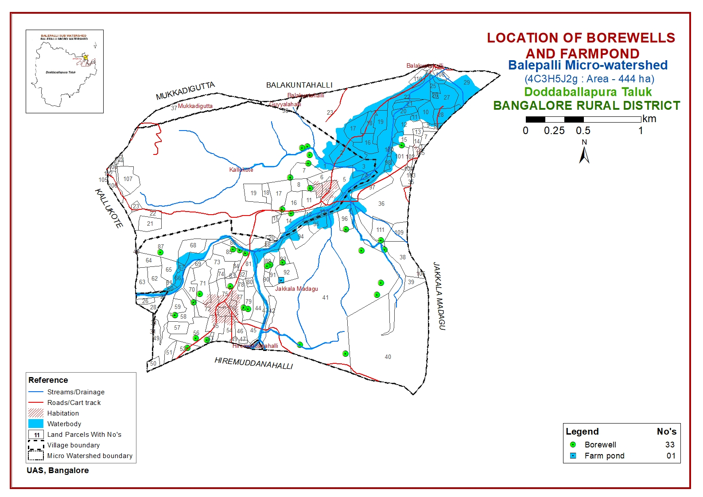

Slide 39
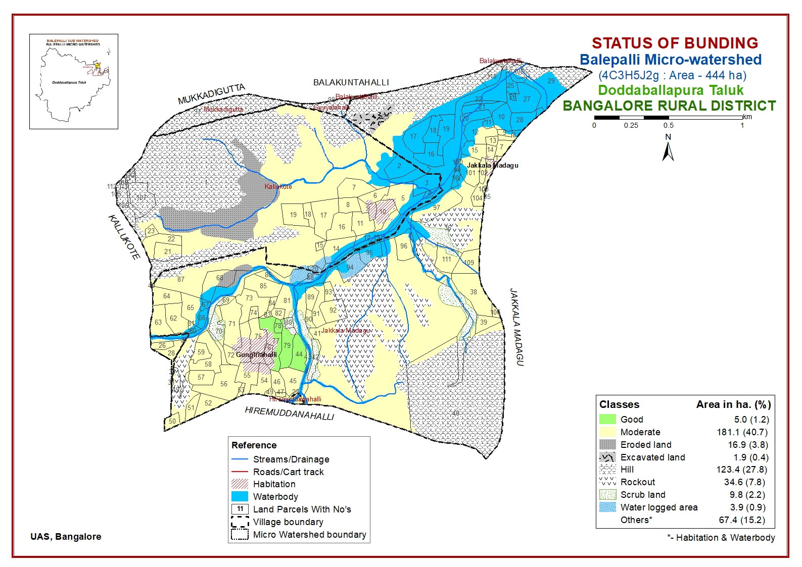

Slide 40
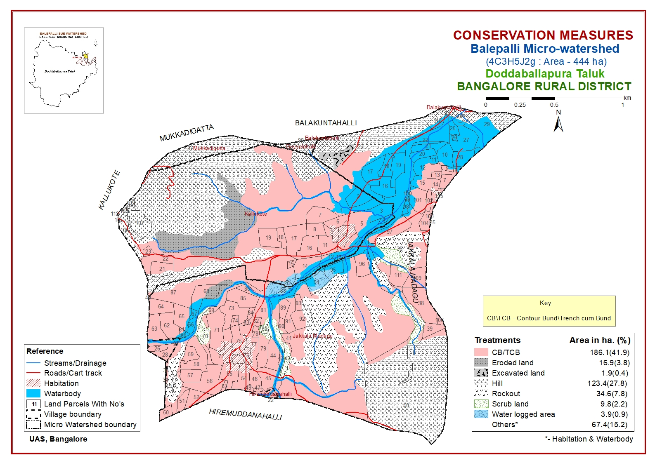

Slide 41
Conclusion
Balepalli micro watershed (4C3H5J2g) covers an area of 444 ha where sandy clay loam and sandy loam soils occupies an area of 75 ha and 59 ha, respectively. Balepalli watershed has moderately shallow (50-75 cm) to moderately deep (75-100) soils accounting for 124 hectare (27.8 %) followed by deep soils (11.8 %) and very deep soils (1.7 %).
The majority of the area 164 ha (37 %) is non gravelly in nature and slight erosion is noticed in 186 hectare (41.9 %) of the total area. Slope varies from very gently sloping to gently sloping lands occupies (41.9 %) of the area.
The micro-watershed is having neutral soils in 104 ha followed by slightly alkaline (8.1 %) and slightly acidic (7.5 %) in nature.
About 24.5 and 23.1 per cent of the area is low in organic carbon and available nitrogen, respectively. The available phosphorous, potassium and sulphur content were medium in 97 ha, 181 ha and 186 ha, respectively. The content of calcium and magnesium was sufficient in entire micro-watershed area with zinc content deficient in 40 ha. The available boron content was low in 131 ha.
Application of organic manures (FYM/compost) is very much needed as per recommendation. The areas which are low in nitrogen, phosphorus, zinc and boron content needs to be provided with suitable fertilizers.

